Slide 1
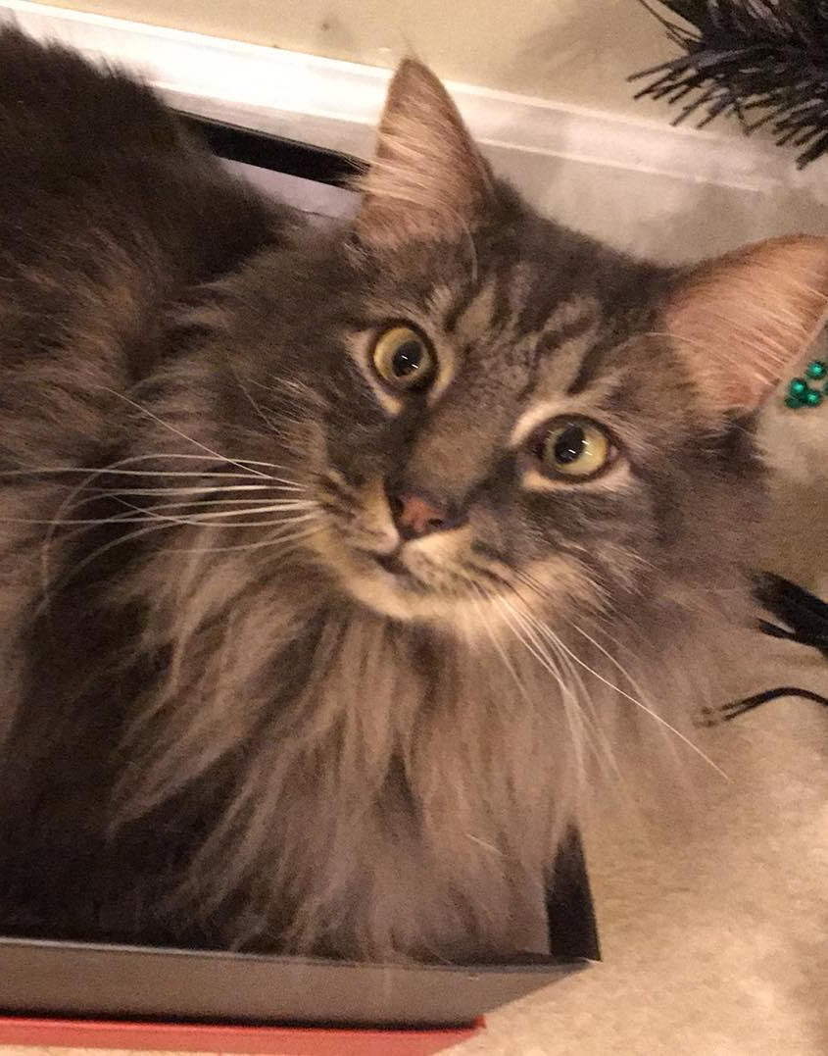
COMMUNICATING RISK
BECAUSE YOU CAN’T TEST EVERYTHING
@jennydoesthings

Slide 2
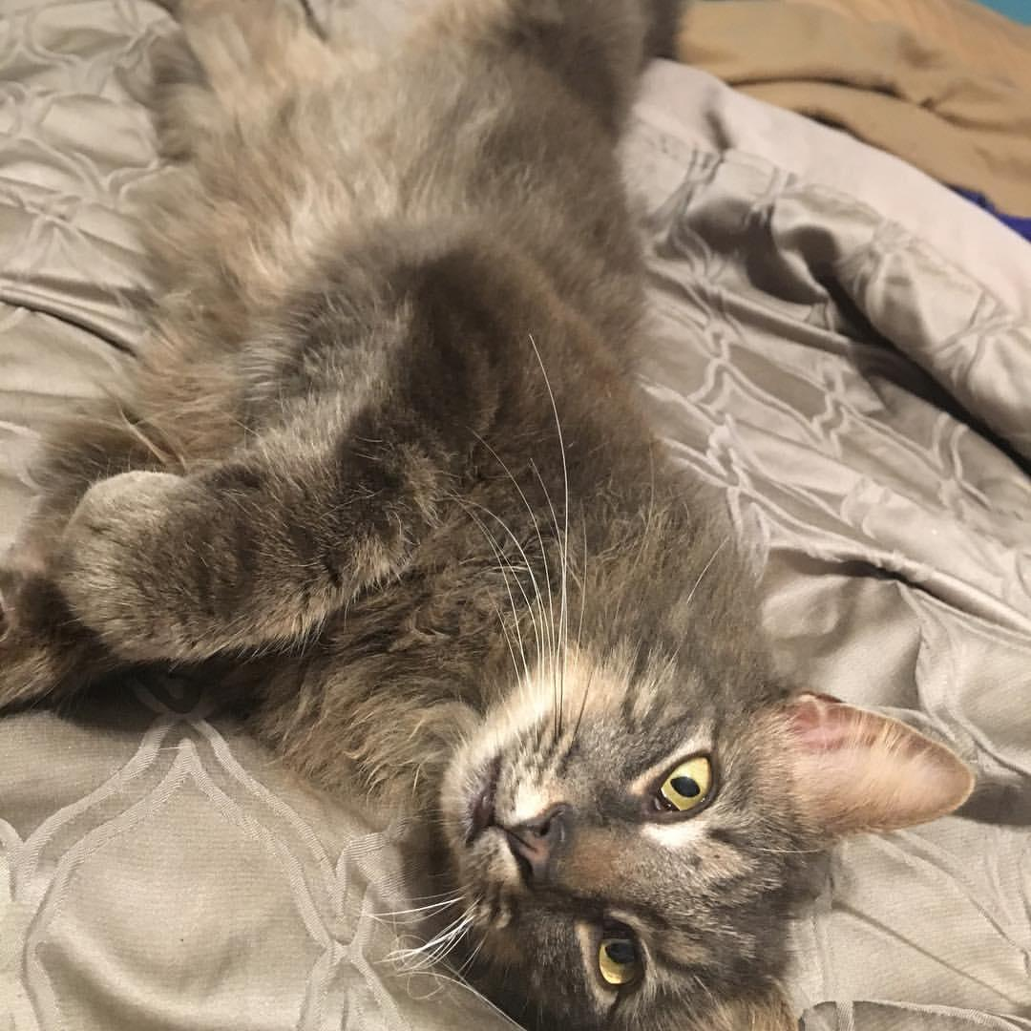
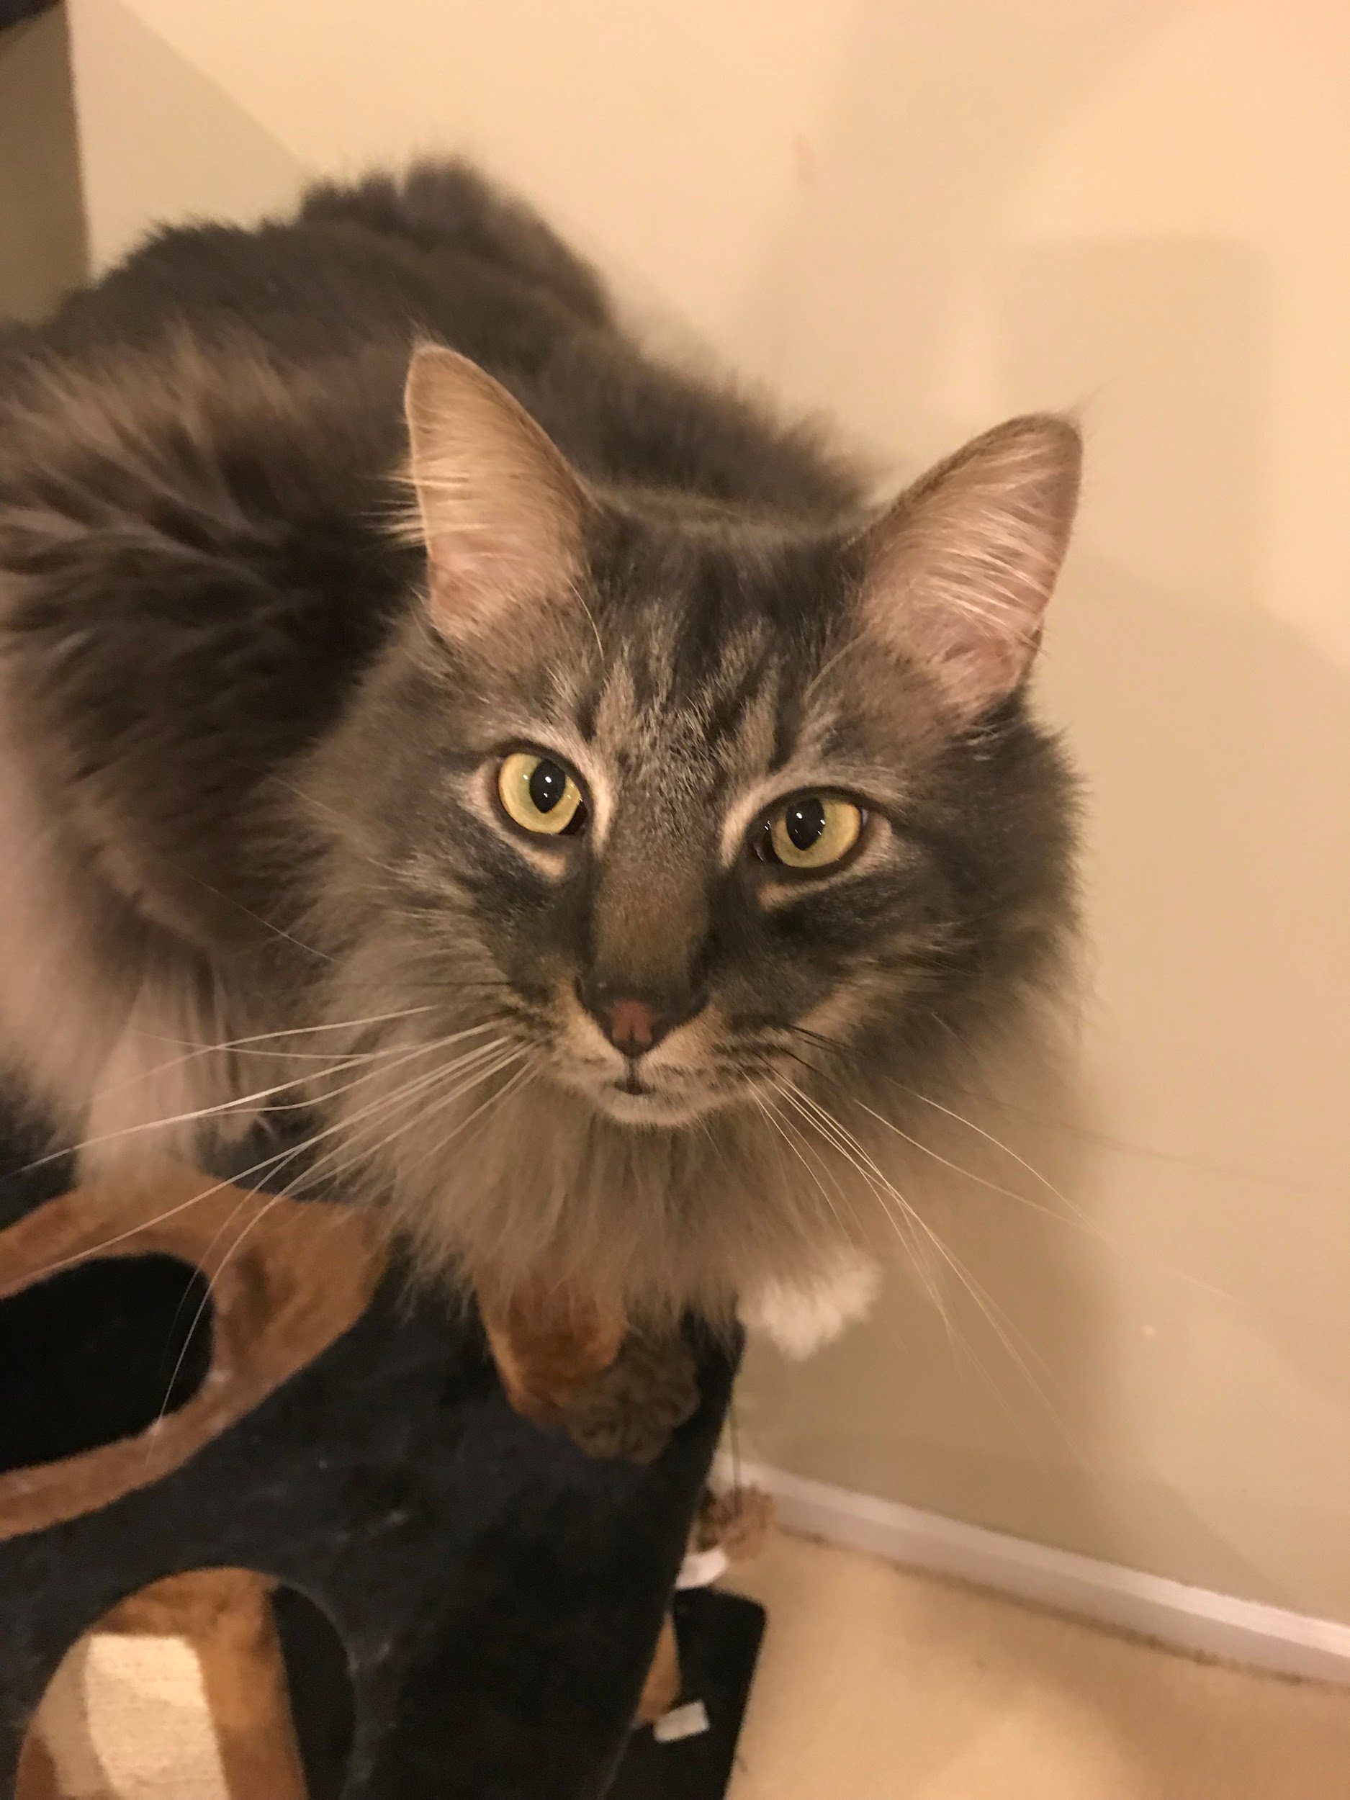
JENNY BRAMBLE
AND DANTE
@jennydoesthings
PRESENTED BY

Slide 3
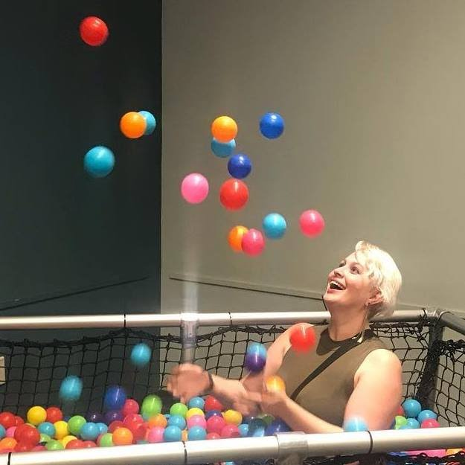
HI, I’M JENNY!
@JENNYDOESTHINGS
I’m currently a Software Test Creature Engineer!
History:
Support —> Devops —> Support again —> QA/Support —> QA
Willowtree Apps is home
Enjoys cats, cupcakes, computers.
jenny.bramble@gmail.com
@jennydoesthings
Pronouns: she/her
Enough about me. Let’s talk about RISK.

Slide 4
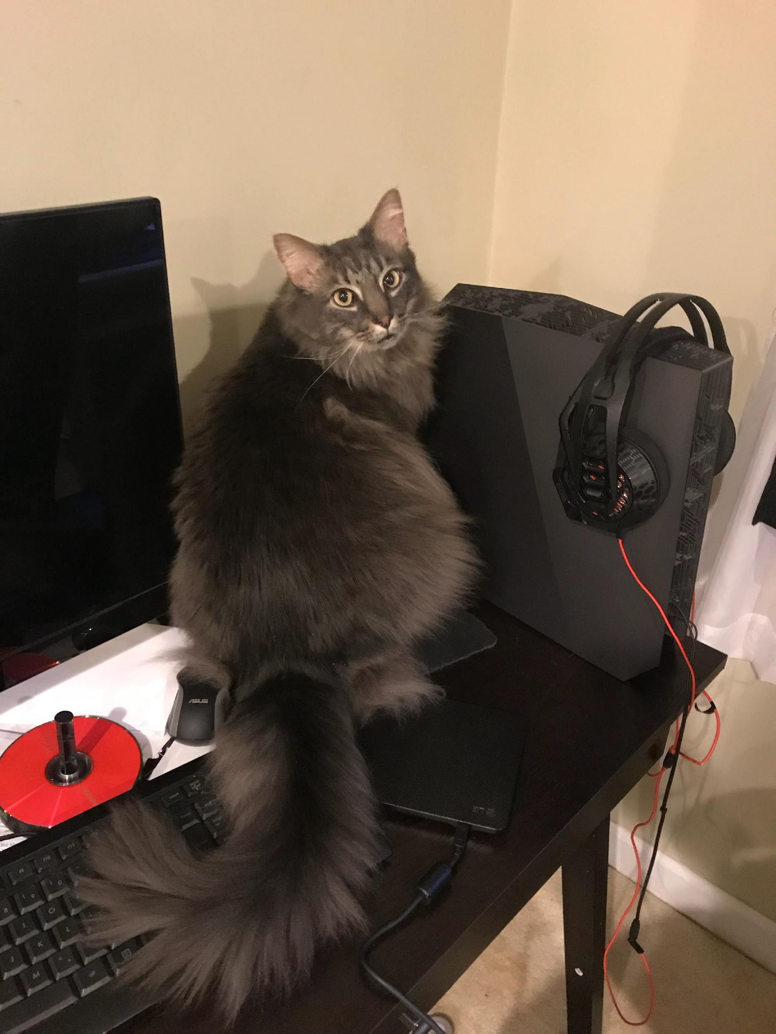
HE TRAPPED HIMSELF IN THE BATHROOM FOR 12 HOURS ONCE.
@jennydoesthings
THIS IS DANTE.

Slide 5
AGENDA
What is my job?
Words are terrible!
Defining risk
Using that definition
Risk matrix and examples
Talking about risk
Additional pictures of cats
Notes:
What is my job?
Words are terrible!
Defining risk
Using that definition
Risk matrix and examples

Slide 6
PLEASE DON’T ASK ME TO TEST EVERYTHING
@jennydoesthings
I CAN’T TEST EVERYTHING

Slide 7
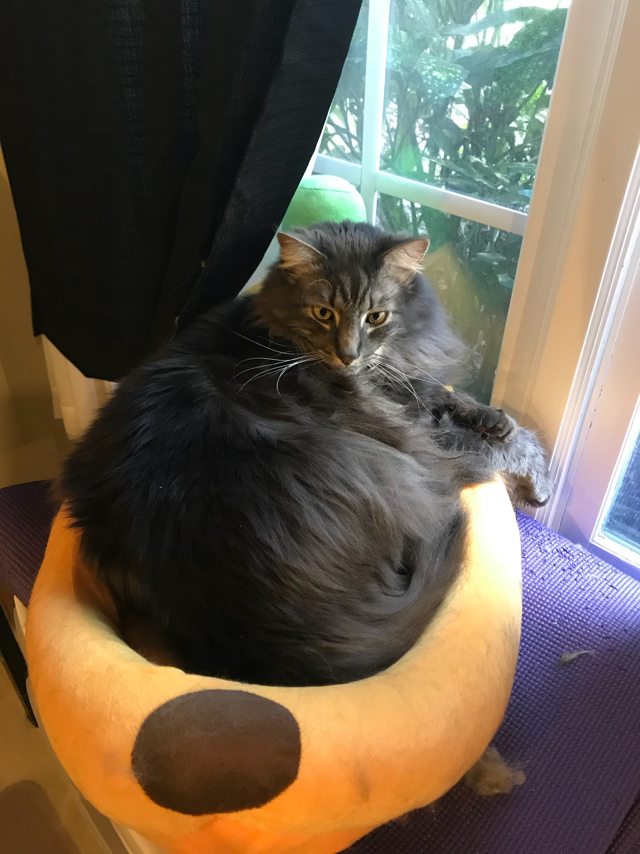
DANTE LIKES NICE THINGS; DON’T QUIT YOUR JOB
@jennydoesthings
DANTE THOUGHT THAT WAS YOUR JOB

Slide 8
THEN WHAT IS?
@jennydoesthings
IF TESTING EVERYTHING ISN’T MY JOB
Notes:
Ask questions. Absorb answers. Translate them.
Verify that systems under test preform in the ways that all the stakeholders expect, or help reset those expectations
Educate other humans about ‘testing’
Advocate for quality practices, methodologies, and thought patterns
Defuse bombs
Evaluate and communicate risk

Slide 9
WHAT IS MY JOB?
Ask questions. Absorb answers. Translate them.
Verify that systems under test preform in the ways that all the stakeholders expect, or help reset those expectations
Educate other humans about ‘testing’
Advocate for practices, methodologies, and thought patterns that encourage quality in the code base and the organization
Defuse bombs
Evaluate and communicate risk
Notes:
Ask questions. Absorb answers. Translate them.
Verify that systems under test preform in the ways that all the stakeholders expect, or help reset those expectations
Educate other humans about ‘testing’
Advocate for practices, methodologies, and thought patterns that encourage quality
Defuse bombs
Evaluate and communicate risk

Slide 10
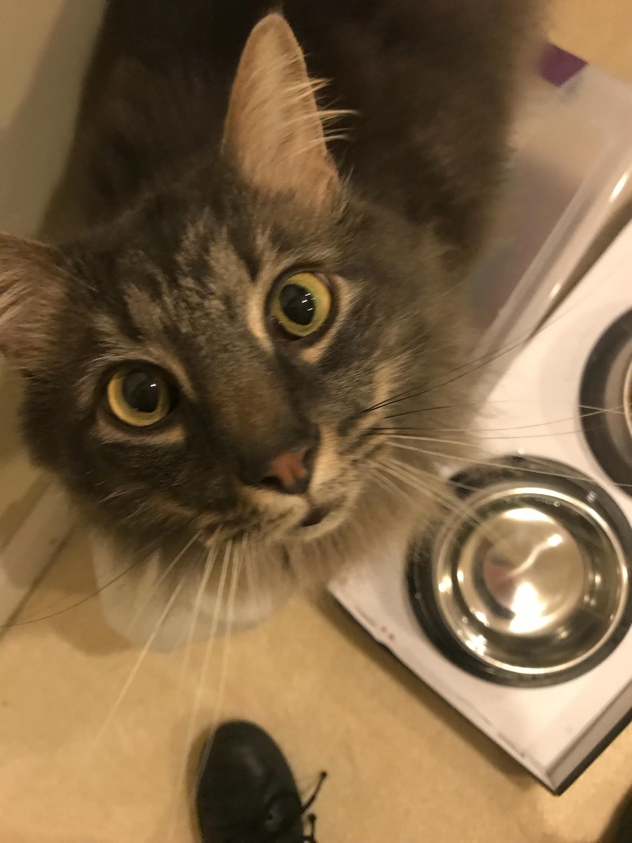
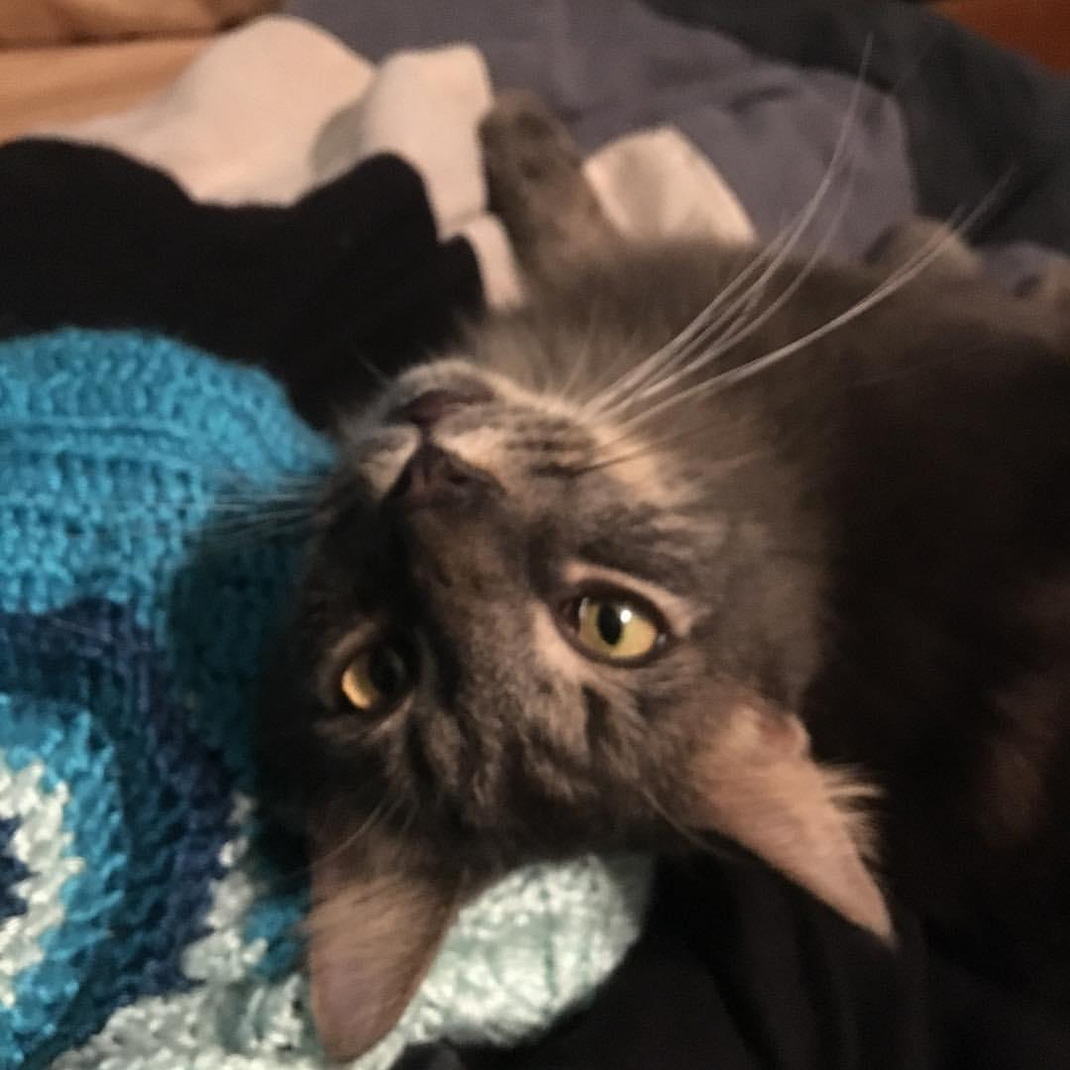
FEEDING DANTE
@jennydoesthings
DANTE THINKS YOUR JOB ALSO ENTAILS

Slide 11
COMMUNICATION
@jennydoesthings
MY JOB COMES DOWN TO ONE THING

Slide 12
RISK
@jennydoesthings
ONE OF THE MAIN THINGS I COMMUNICATE

Slide 13
RIGHT?
@jennydoesthings
EVERYONE KNOWS WHAT RISK IS

Slide 14
I LIKE MY COFFEE SWEET
@jennydoesthings
MY SISTER LIKES HER COFFEE SWEET
Notes:
She likes a teaspoon of sugar.
I like a half cup of sugar.
I say risk and it means one thing. It means another to my PM.

Slide 15
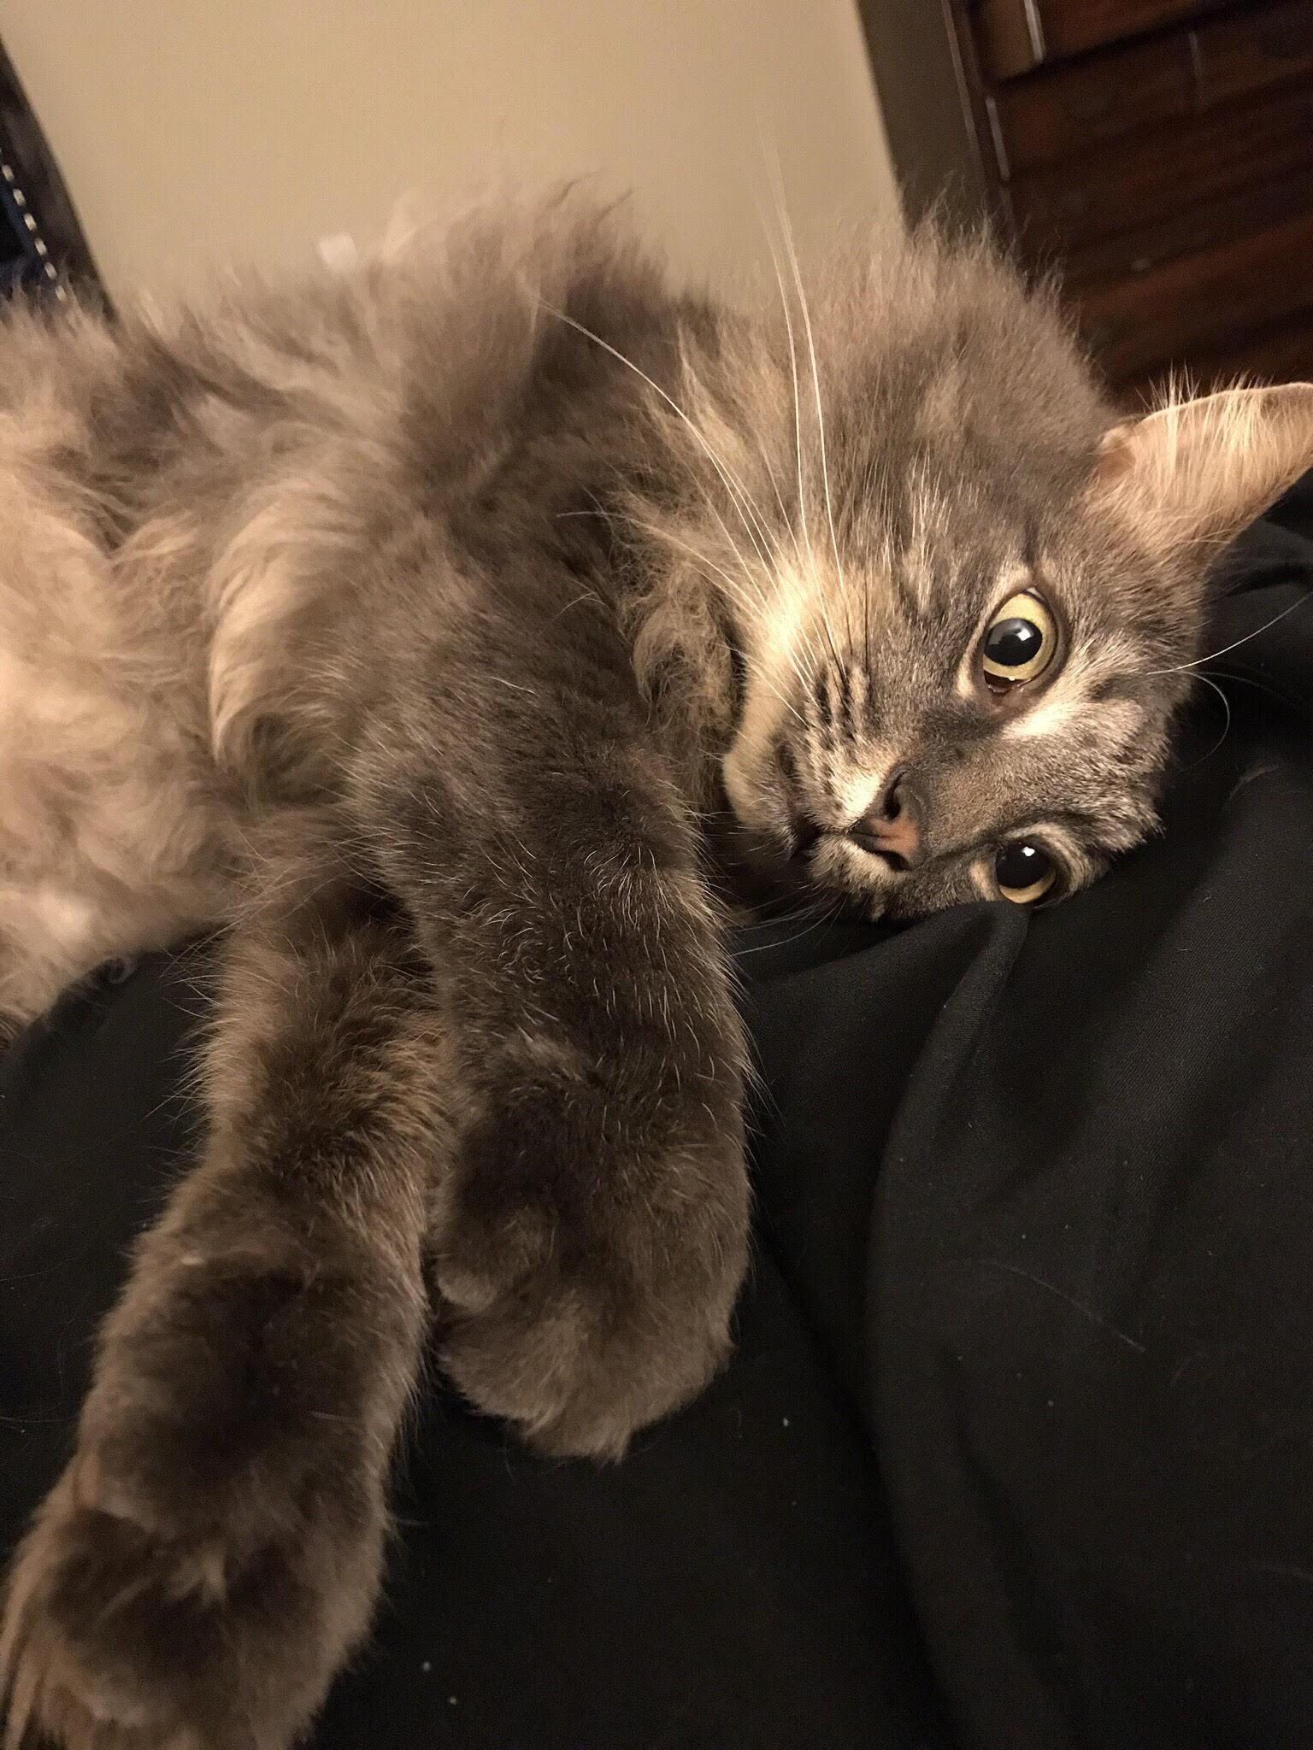
NOW HE’S QUESTIONING EVERYTHING
@jennydoesthings
DANTE THOUGHT HE KNEW

Slide 16
WORDS ARE THE WORST WAY TO COMMUNICATE
@jennydoesthings
WHEN IT COMES DOWN TO IT
Notes:
I have so many emotions. So. Very. Many

Slide 17
AND MAKE THEM MEANINGFUL
@jennydoesthings
BUT WE CAN MAKE THEM BETTER
Notes:
I have so many emotions. So. Very. Many

Slide 18
WORDS ARE THE WORST WAY TO COMMUNICATE BUT…
Defining terms lets us communicate across cross-functional teams
Using the same words AND meanings
It gives us an ability to justify our decisions to people outside our sphere
Give updates that have depth
Help determine what resources we need to apply to a project
Notes:
Defining terms lets us communicate across cross-functional teams
Using the same words AND meanings
It gives us an ability to justify our decisions to people outside our sphere
Give updates that have depth
Help determine what resources we need to apply to a project

Slide 19
BECAUSE WE ALL KNOW WHAT WE’RE TALKING ABOUT
@jennydoesthings
WE CAN NOW COMMUNICATE MORE CLEARLY AND PRECISELY

Slide 20
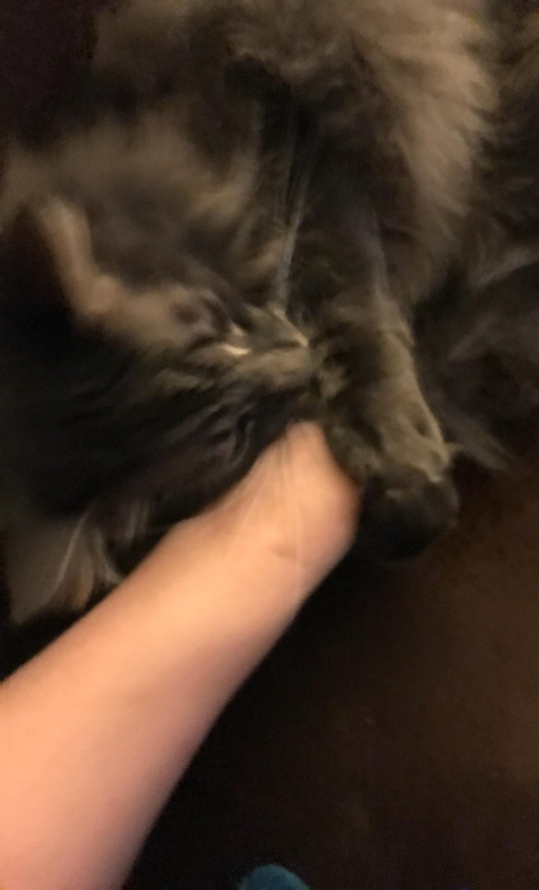
WITH BITING (AND SOME CRYING)
@jennydoesthings
DANTE EXCLUSIVELY COMMUNICATES

Slide 21
WHAT IS RISK?
Anything that can go wrong
Something awful
A scary situation
A headline bug
Running out of cat food
EVERYBODY PANIC
PRODUCTION IS DOWN
WE ARE ALL GOING TO GET FIRED
Notes:
Anything that can go wrong
Something awful
A scary situation
A headline bug
Running out of cat food
EVERYBODY PANIC
PRODUCTION IS DOWN
WE ARE ALL GOING TO GET FIRED

Slide 22
RISK
@jennydoesthings
THE IMPACT OF FAILURE
THE PROBABILITY THAT FAILURE WILL OCCUR

Slide 23
AND HE WOULD LIKE TO KNOW MORE
@jennydoesthings
THIS INTERESTS DANTE

Slide 24
IMPACT OF FAILURE
@jennydoesthings
ANY POTENTIAL NEGATIVE IMPACT CONTRIBUTES TO THE RISK OF AN APPLICATION OR FEATURE

Slide 25
IMPACT OF FAILURE
Technical
Loss of data
Introduction of security flaws
Business
Revenue cannot be collected
Critical functions cannot be performed
Morale
Users have to utilize workarounds
Slowed workflows
Utilization of pitchforks and torches
Notes:
Technical
—Loss of data
—Introduction of security flaws
Business
—Revenue cannot be collected
—Critical functions cannot be performed
Morale
—Users have to utilize workarounds
—Slowed workflows
—Utilization of pitchforks and torches

Slide 26
IMPACT OF FAILURE
@jennydoesthings
WHAT’S IMPACTFUL TO THE COMPANY?

Slide 27
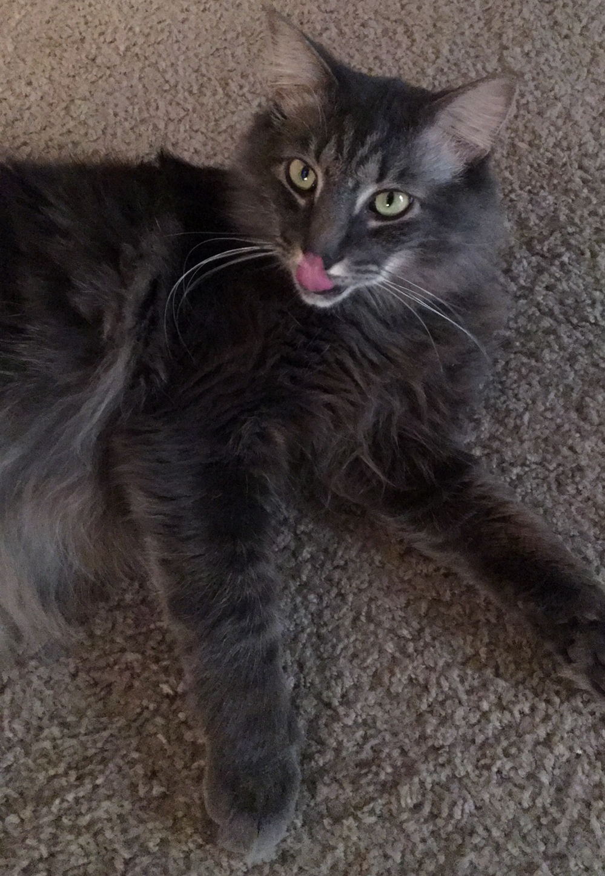
THE IMPACT OF LEAVING HIM FOR THE WEEKEND IS EVERYTHING “FALLS” OFF THE TABLE.
@jennydoesthings
DANTE GETS IT

Slide 28
PROBABILITY OF FAILURE
@jennydoesthings
THE LIKELIHOOD THAT THE APPLICATION, FEATURE, OR USE CASE WILL FAIL

Slide 29
PROBABILITY OF FAILURE
Has this failed before?
Has something similar failed before?
Historical data tells you about past failure
Defects
Tribal knowledge
QCA/RCA
That person that’s been here forever and knows everything
Notes:
Simply, the likelihood the feature, application, or use case will fail.
Don’t worry--there’s no math, just thinking
Use historical data to consider if there has been failure before within this application, feature, or use case
Historical data can come in many forms
QCA/RCA documents
QA defects
Tribal knowledge
Talk to everyone!
Miscalculating impact or probability during testing can mean greater failures down the line.

Slide 30
PROBABILITY OF FAILURE
What features do users interact with the most?
How do they interact with these features?
What’s inherently fragile about our code base?
Are there external changes to consider?
How do you feel about it?
Are you proud of the feature?
Notes:
What features do users interact with the most?
How do they interact with these features?
What’s inherently fragile about our code base?
Are there external changes to consider?
How do you feel about it?
Are you proud of the feature?

Slide 31
PROBABILITY OF FAILURE
@jennydoesthings
THESE ARE VERY EDUCATED GUESSES ABOUT WHAT MIGHT FAIL

Slide 32
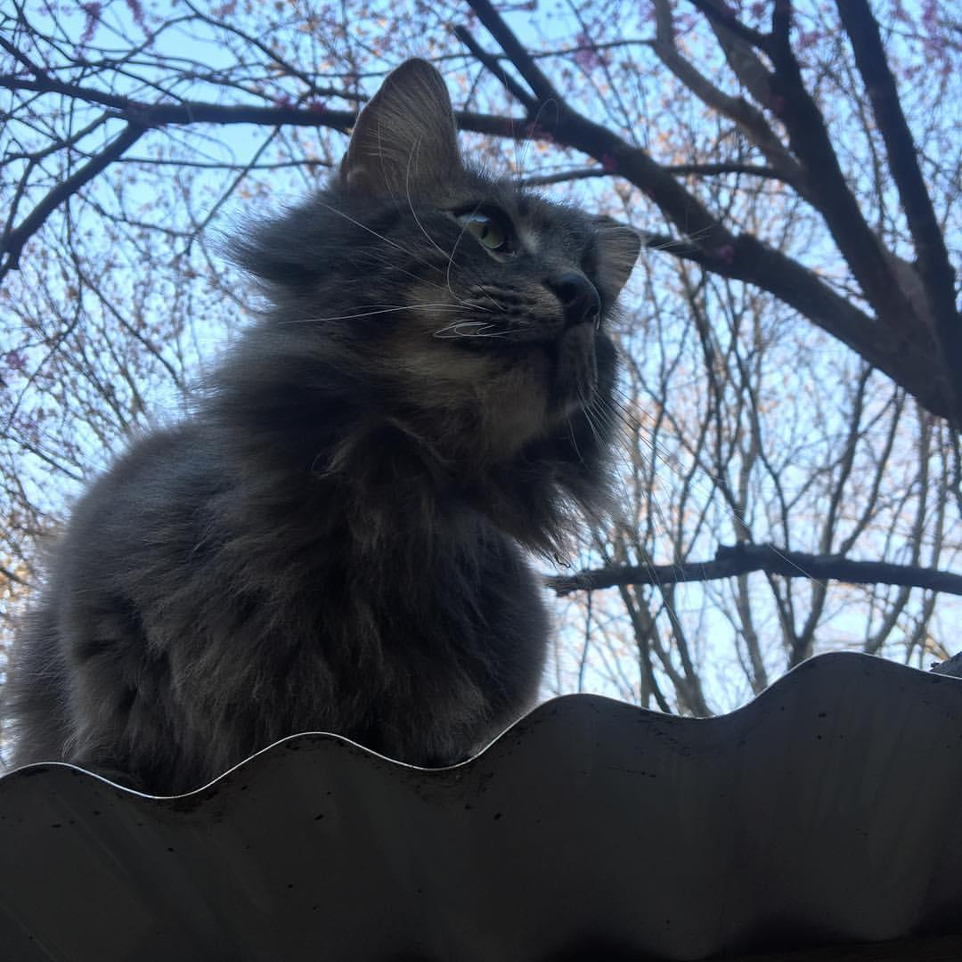
JUMPING OFF THE ROOF HAS A LOT OF RISK.
@jennydoesthings
DANTE IS PRETTY SURE

Slide 33
OTHER TYPES OF RISK
@jennydoesthings
FACTORS OUTSIDE OF YOUR FEATURE, USE CASE, OR APPLICATION

Slide 34
OTHER TYPES OF RISKS
Modified time table
Environment issues
New or inexperienced team members
Natural disasters
Sickness
Outside pressure
Industry-specific risks
Notes:
Modified time table
Environment issues
New or inexperienced team members
Natural disasters
Sickness
Outside pressure
Industry-specific risks

Slide 35
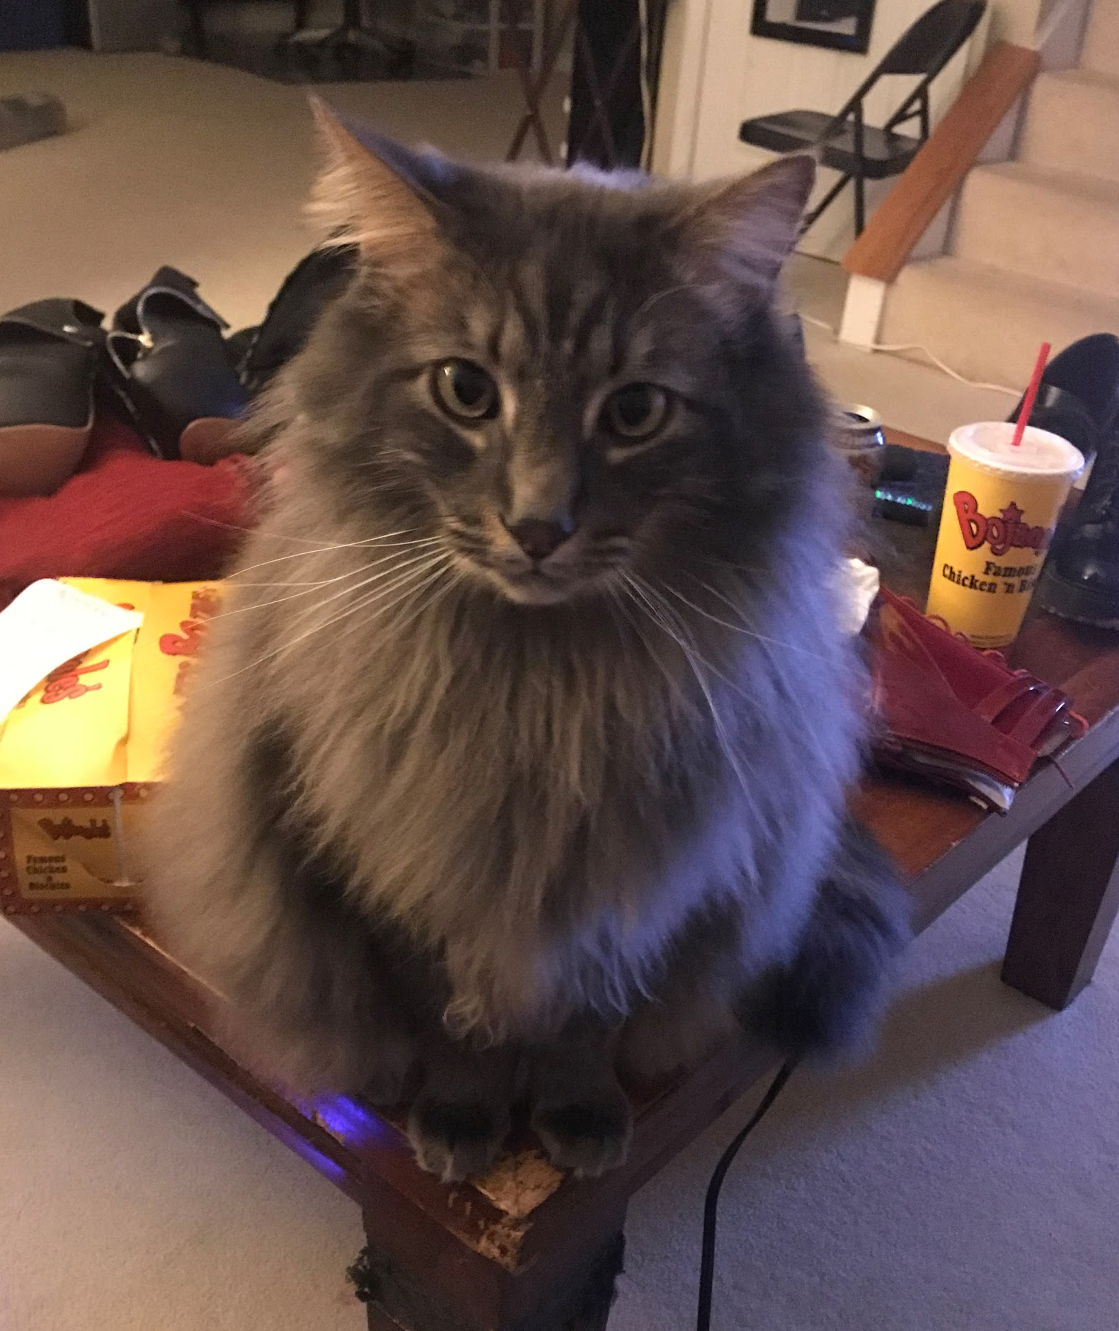
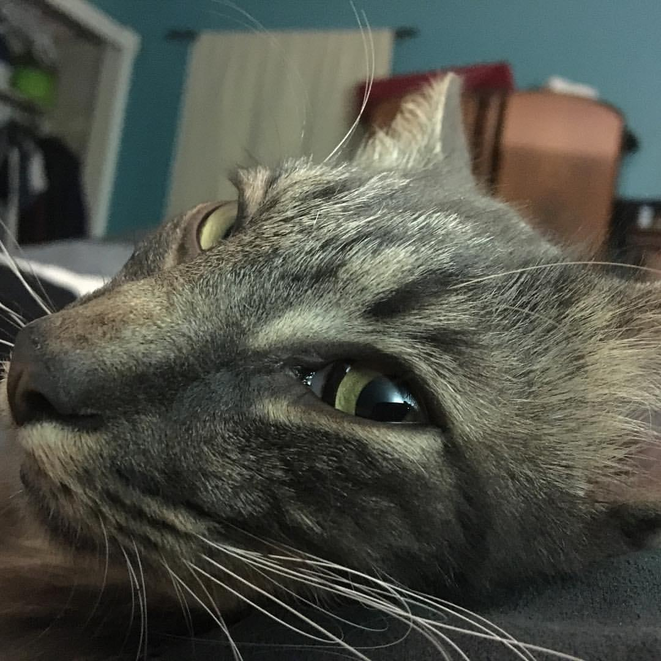
IS IT REALLY NECESSARY?
@jennydoesthings
DANTE FEELS THAT’S A LOT TO THINK ABOUT.

Slide 36
WE CAN’T TEST EVERYTHING
@jennydoesthings
WE HAVE LIMITED TIME, BODIES, ATTENTION, MONEY, AND OTHER RESOURCES
Notes:
Even if we had unlimited resources
“Testing everything” is ridiculous
“Testing everything” is impossible
“Testing everything” is a terrible use of resources
So we assess risk and use this to determine where we focus our testing efforts.

Slide 37
COMMUNICATE CLEARLY AND PRECISELY WHY WE TEST WHAT WE TEST
@jennydoesthings
WHAT WE CAN DO IS
Notes:
Many times, other humans involved in the project misunderstand ‘testing’.
We have a responsibility to educate them on several points:
What we do
What we have time for
Why we make our choices
This increases our team’s ability to create good software.
We start to make stronger teams that have a better understanding of each other.
Risk becomes part of our sprint’s base work in grooming and sizing.

Slide 38
AND WHEN I SAY “TEST”, I MEAN…
Giving more attention to one item than another
Raising concerns about a feature
Discussing the need for more resources
Choosing what stories to play
Asking for more time on a project
Manual and automated testing efforts
Notes:
Giving more attention to one item than another
Raising concerns about a feature
Discussing the need for more resources
Choosing what stories to play
Asking for more time on a project
Manual and automated testing efforts

Slide 39
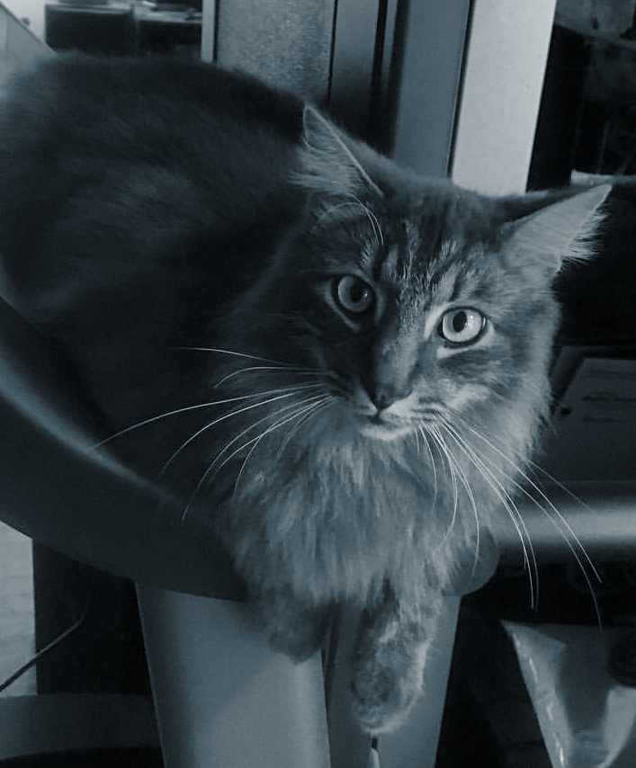
A SERIOUS DISCUSSION ABOUT RISK
@jennydoesthings
DANTE THINKS WE SHOULD HAVE

Slide 40
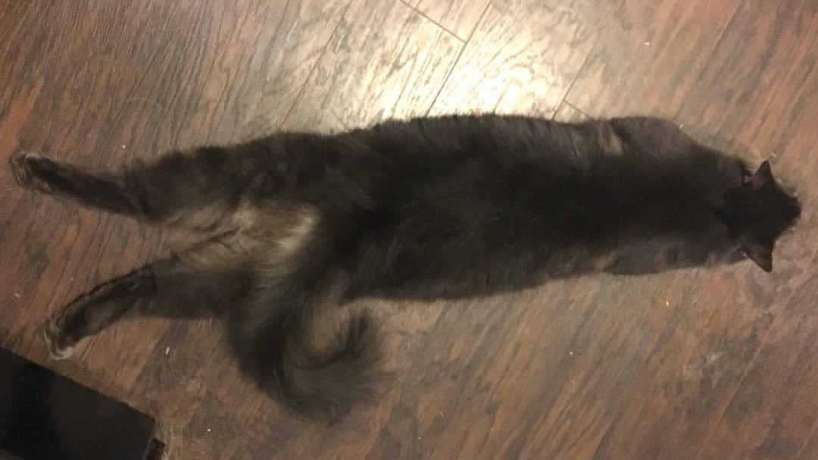
DANTE JUST WANTS TO TAKE NAPS
@jennydoesthings
HAHA, NAAAAAH

Slide 41
YES: RISK MATRIX
@jennydoesthings
CAN WE MAKE THIS EASIER VISUALLY?

Slide 42
DO MATH
@jennydoesthings
FIRST THINGS FIRST

Slide 43
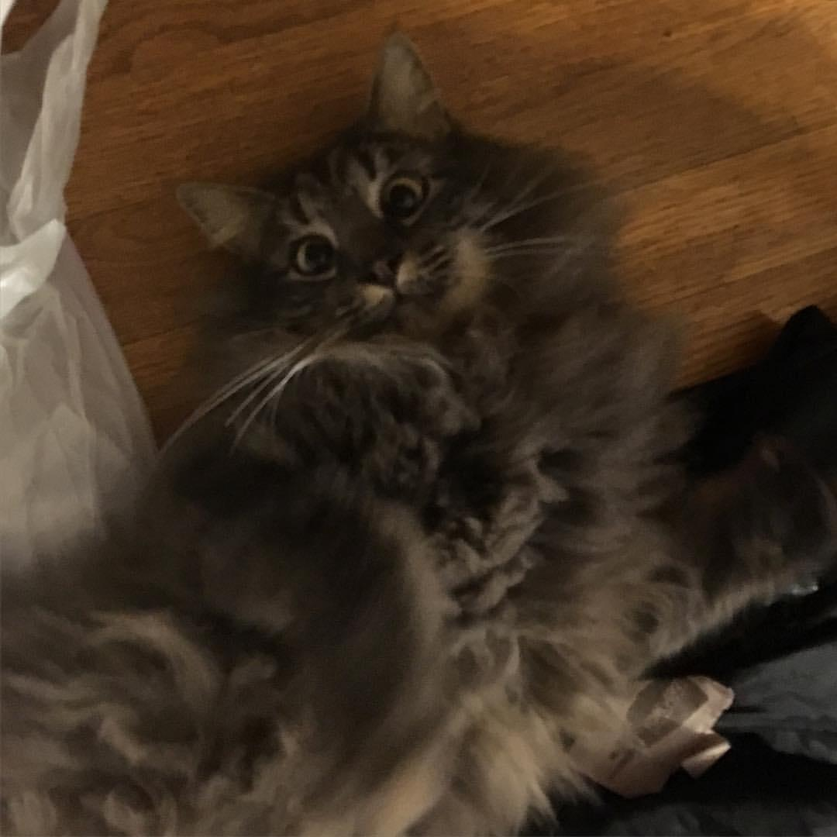
THERE WASN’T GOING TO BE MATH
@jennydoesthings
DANTE THOUGHT

Slide 44
WHAT IT IS DOESN’T MATTER AS LONG AS IT MAKES SENSE
@jennydoesthings
DETERMINE A RATING SYSTEM
Notes:
Can we make this easier visually?
Yep--make a risk matrix
Determine a rating system
Doesn’t matter as long as it’s consistent
You can use numbers or phrases like high/med/low
Make your items as granular as possible
Start on the feature level
Then break it down to individual tests or use cases
Determine the Impact of Failure and Probability of Failure
Do math! (#sorrynotsorry)
You will be left with a number that can help you evaluate risk.

Slide 45
MAKE A RISK MATRIX
@jennydoesthings
NOW, DOCUMENT IT
Notes:
Can we make this easier visually?
Yep--make a risk matrix
Determine a rating system
Doesn’t matter as long as it’s consistent
You can use numbers or phrases like high/med/low
Make your items as granular as possible
Start on the feature level
Then break it down to individual tests or use cases
Determine the Impact of Failure and Probability of Failure
Do math! (#sorrynotsorry)
You will be left with a number that can help you evaluate risk.

Slide 46
@jennydoesthings
Item/Story/Use Case | Impact of Failure | Probability of Failure | Risk
Send user email confirming their recent purchase | 7 | 3 | 21
Shopping cart redirect to PayPal | 9 | 2 | 18
Adding a newly created item type to a shopping cart | 9 | 6 | 54

Slide 47
OTHER ELEMENTS OF A RISK MATRIX
You can include a breakdown of the types of risk if it’s hard to pull out one number
Usage
Fragility
Merges
Environmental issues
User frustration
User familiarity
Risks may also vary depending on the phase of the project and environment
Notes:
You can include a breakdown of the types of risk if it’s hard to pull out one number
Usage
Fragility
Merges
Environmental issues
User frustration
User familiarity
Risks may also vary depending on the phase of the project and environment

Slide 48
RISK MATRIX
@jennydoesthings
COMPLEX OR SIMPLE, AS LONG AS IT CONVEYS THE CORRECT INFORMATION

Slide 49
REAL WORLD EXAMPLE
@jennydoesthings
HOW DO WE TELL THE STORY OF A PROJECT ON THE RAILS?
Notes:
Sitting in a room with an entire team, a project on the rails, and a spreadsheet of issues we’d found.
How do we start telling the story of this project?
How do we argue for more time?
We started by assigning ‘risk’ to features.
This devolved into arguing about what ‘risk’ meant.
Our solution was to break it down into sections and types of risk.
Finally, we could have a meaningful conversation.

Slide 50
REAL WORLD EXAMPLE
We were able to describe the project in terms of risks and effects.
Risk to the user (of catastrophic failure)
Risk to engineering (of technical debt)
Risk to the team (of failing sprints)
When we could fix specific issues (before or after release to production)
I also argued for a ‘pitchfork index.’
Notes:
We were able to describe the project in terms of risks and effects.
Risk to the user (of catastrophic failure)
Risk to engineering (of technical debt)
Risk to the team (of failing sprints)
When we could fix specific issues (before or after release to production)
I also argued for a ‘pitchfork index.’

Slide 51
REAL WORLD EXAMPLE
@jennydoesthings
OUR CONVERSATION TURNED INTO ACTION, GAINING EXTRA TIME TO HARDEN THE PRODUCT.

Slide 52
WITH EVERYONE INVOLVED
@jennydoesthings
DANTE DISCUSSES RISK
Notes:
Look at the whole feature and specific use cases.
How can the feature be used?
How do users interact with the feature in particular use cases?
How likely is that use case?
How likely is that use case to fail?
What happens if that use case fails?
Catastrophic failure
Degraded functionality
No significant impact
Consider outside influences that may contribute to risk.
Think about risk early and often.

Slide 53
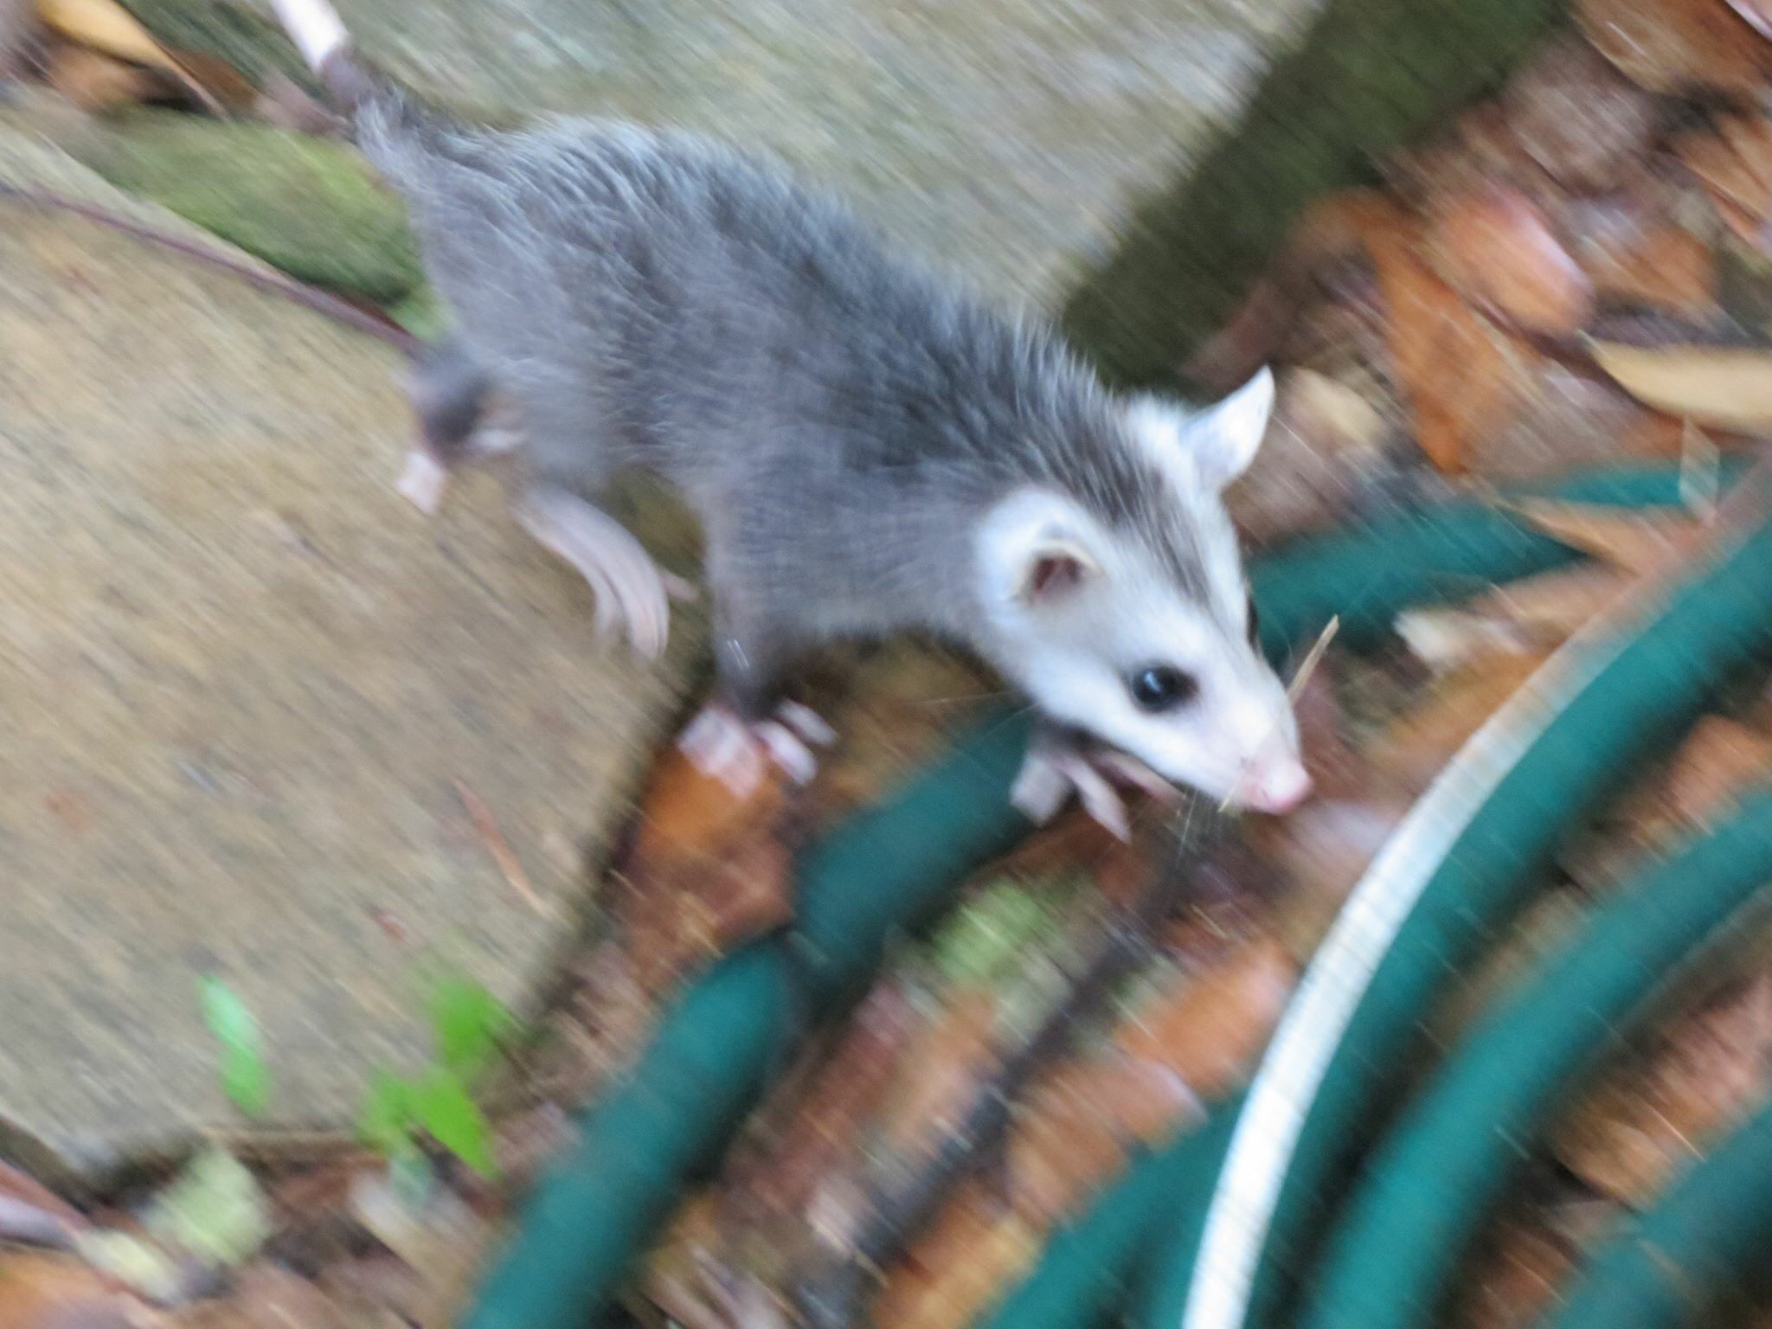
NO FRIENDS WERE HARMED IN THE MAKING OF THIS PRESENTATION
@jennydoesthings

Slide 54
WE CAN BECOME A BETTER, MORE COHESIVE TEAM
@jennydoesthings
THE MORE WE TALK ABOUT RISK
Notes:
The more we talk about risk, the more we can talk about risk.
We begin to identify places that make us ‘nervous’.
We can talk about our ‘gut feelings’ in concrete terms
Everyone has a better idea of what’s involved in implementing or changing features
Our testing predictions become more accurate.
Other humans can predict testing burden.
Better teamwork comes from better communication.

Slide 55
HOW DOES THIS HELP US?
@jennydoesthings
WE CAN USE RISK FOR MORE THOUGHTFUL TESTING AND CONVERSATIONS
Notes:
This lets us evaluate ourselves in terms of thoughtful testing.
Where do we spend most of our time?
Are we looking at the areas that we feel are most risky, or taking the easy stuff first?
Do we have enough resources for the testing burdens we have?
Are we delegating correctly?
We need to self-evaluate and this gives us another metric to look at personally.

Slide 56
HOW DOES THIS HELP US?
@jennydoesthings
WE CAN USE RISK FOR MORE THOUGHTFUL TESTING AND CONVERSATIONS
Notes:
This gives us a framework to talk about what we’re going to test in a sprint and what needs priority.
Where do we get the most bang for our buck?
What needs the most attention?
What needs the least?
What’s a good candidate for automation?
What should we test on production? Staging? Dev?
We gain more focus and more thoughtful testing which leads us to a better application.

Slide 57
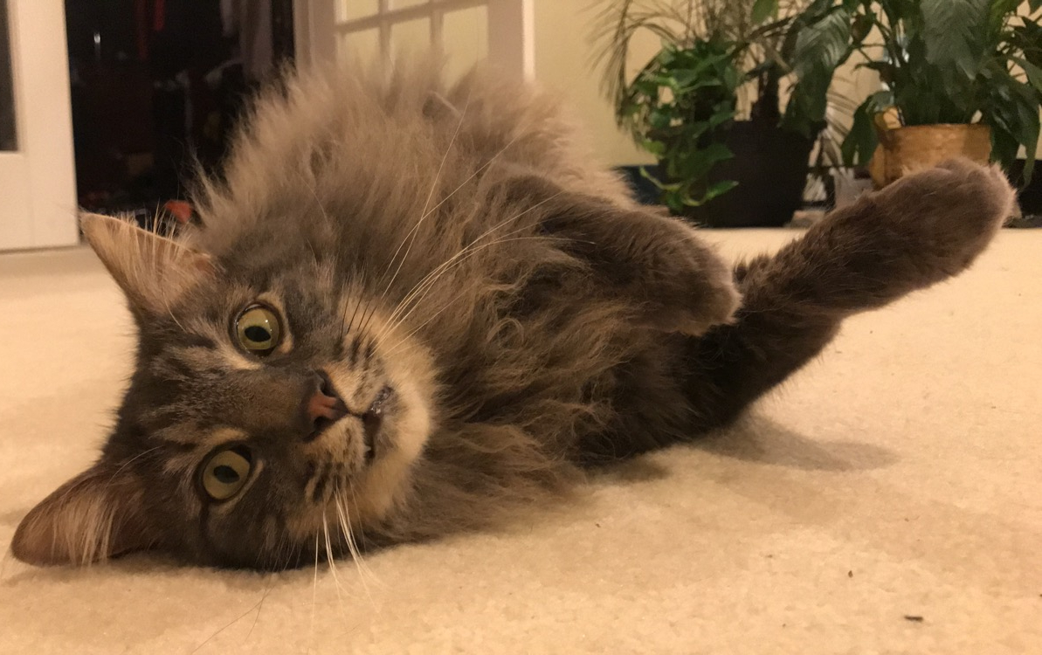
THINKING ABOUT RISK
@jennydoesthings
DANTE SOMETIMES GETS OVERWHELMED

Slide 58
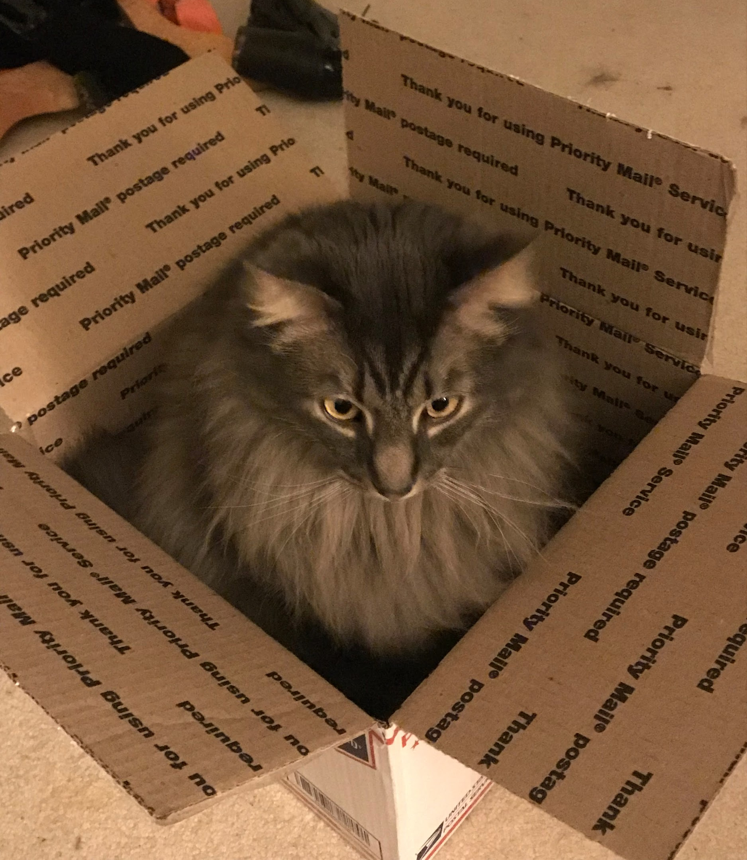
DANTE GETS OVERWHELMED A LOT
@jennydoesthings
TO BE FAIR

Slide 59
AGENDA
What is my job?
Words are terrible!
Defining risk
Using that definition
Risk matrix and examples
Talking about risk
Additional pictures of cats
Notes:
What is my job?
Words are terrible!
Defining risk
Using that definition
Risk matrix and examples

Slide 60
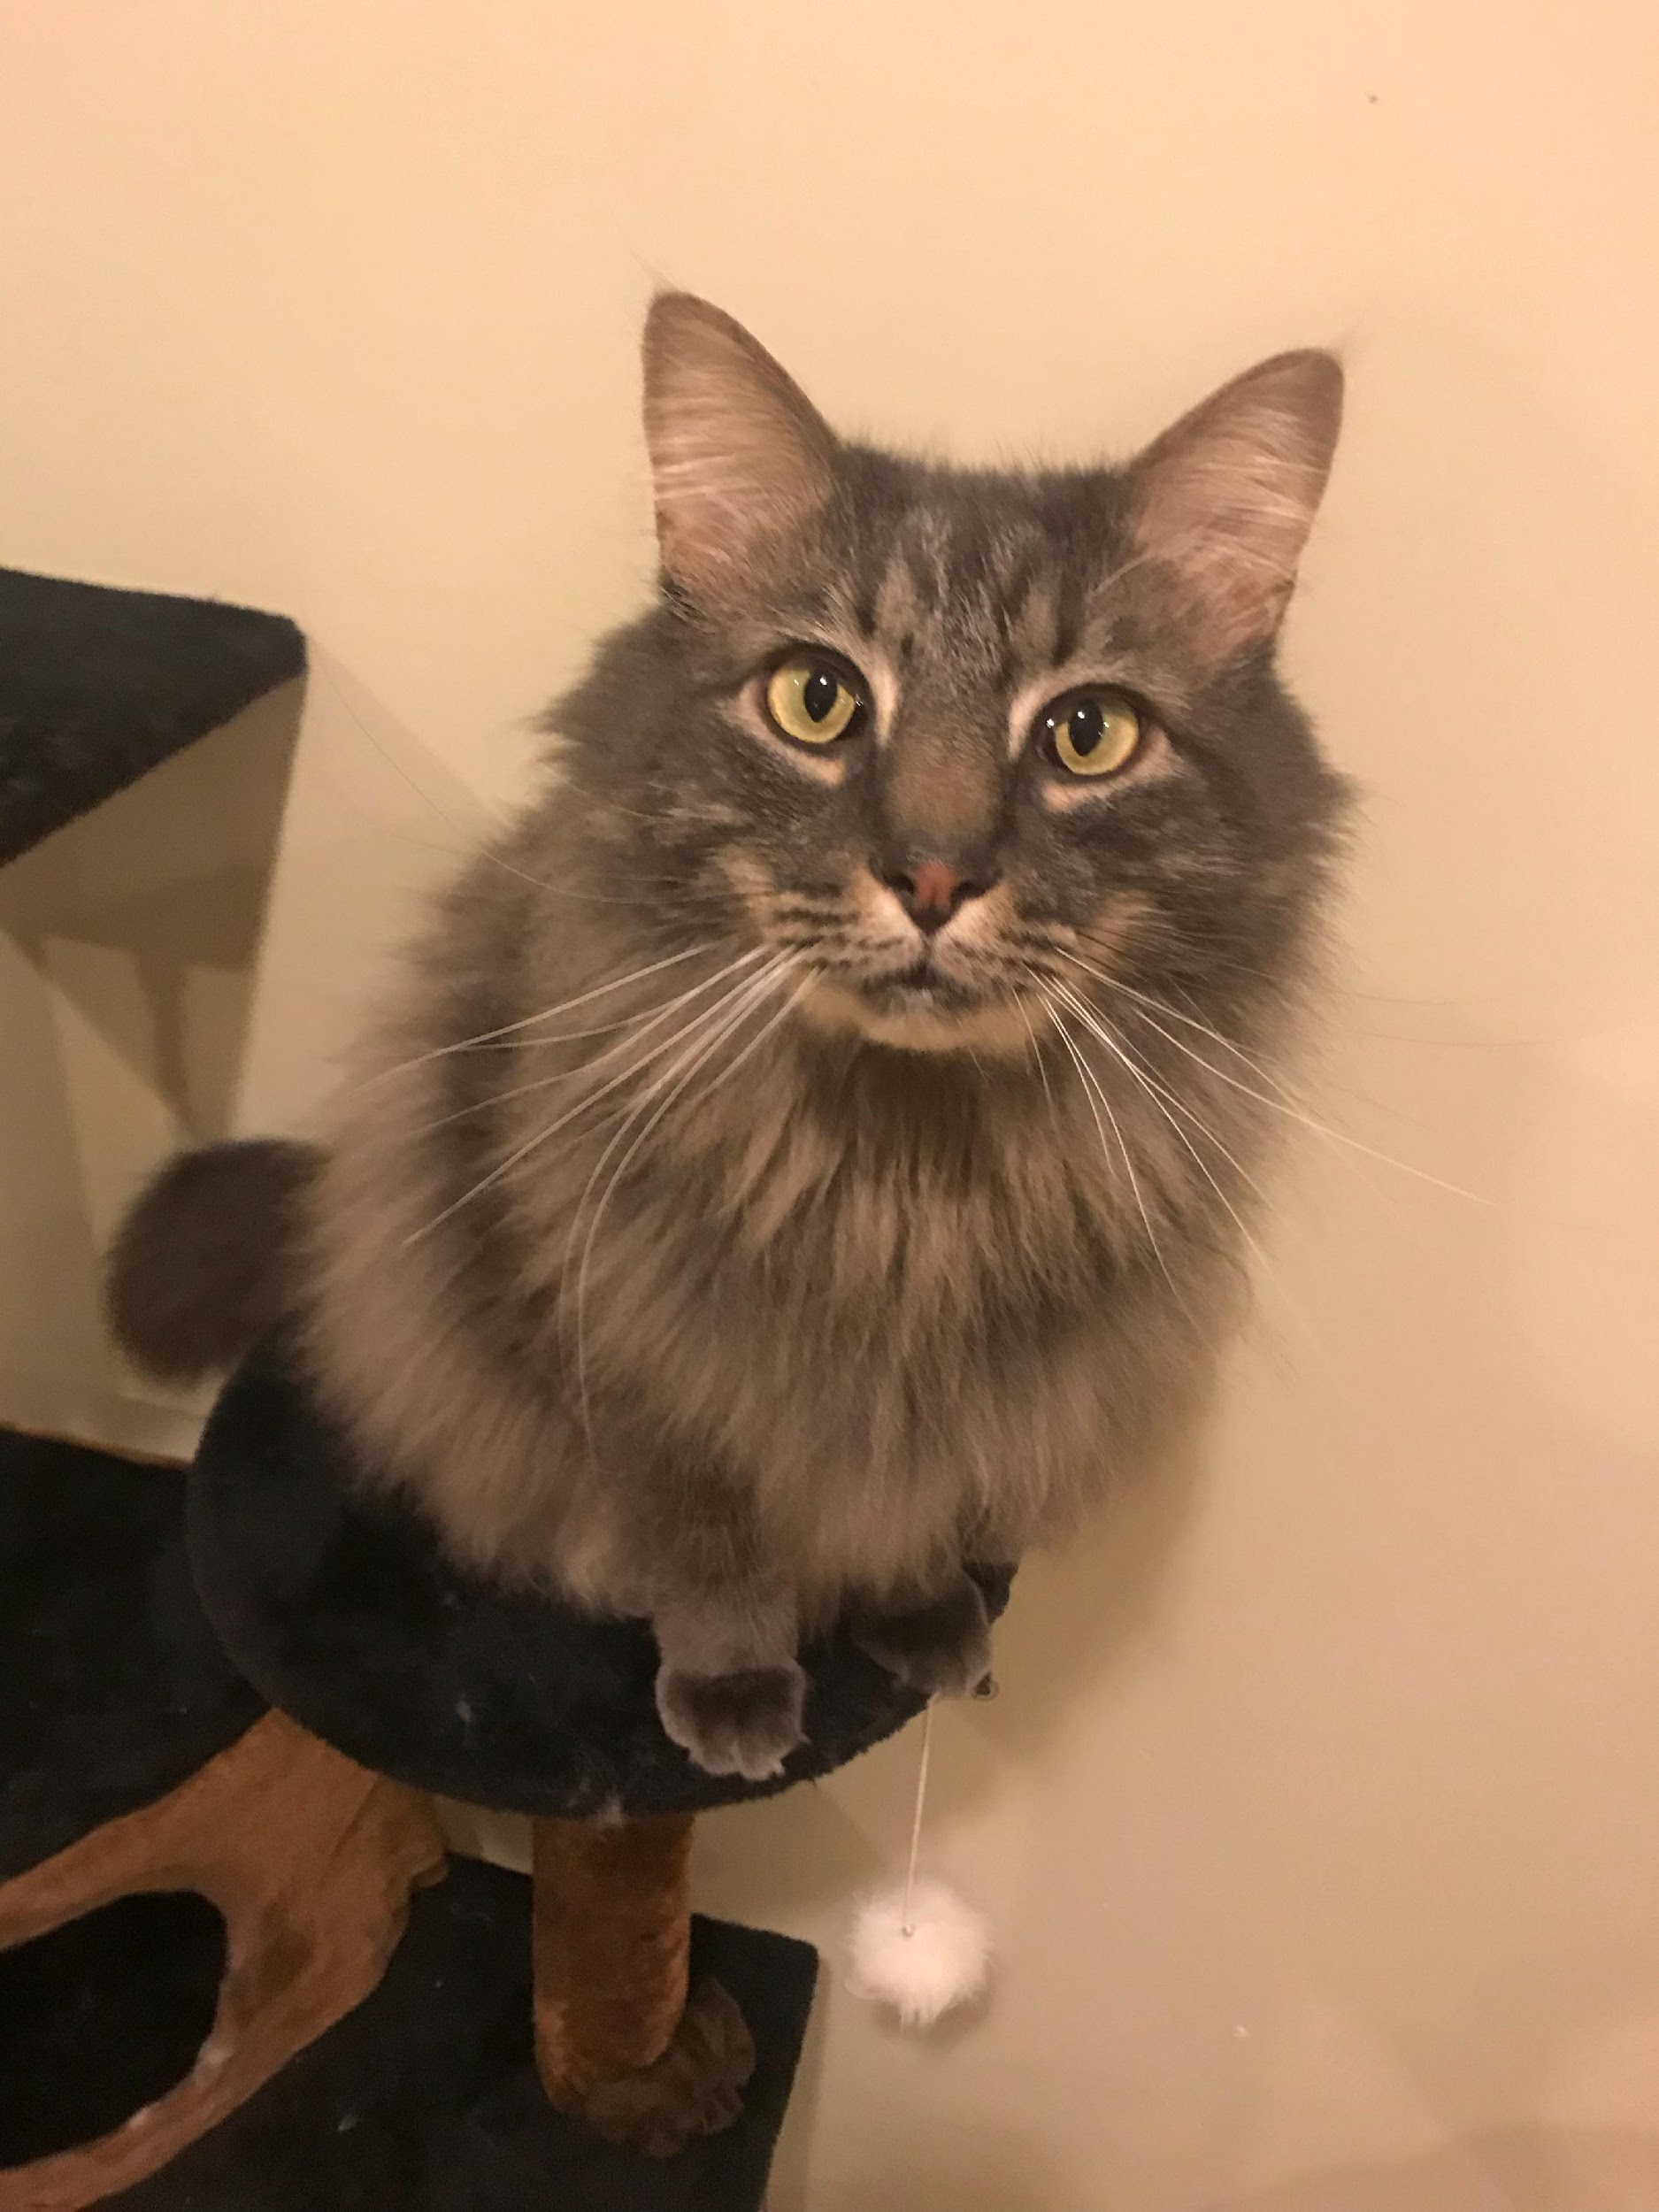
CONVERSATION STARTERS
@JENNYDOESTHINGS
How do you define risk?
How do you tell the story of your application, feature, or use case?
What’s your job title? Your job?
In retrospect, when should you have spoken up? What resources do you need to make that easier next time?
What takes a lot of your time at work?
Sometimes, it takes a lot of “spoons” to start these conversations. Be kind and soft, like Dante.

Slide 61
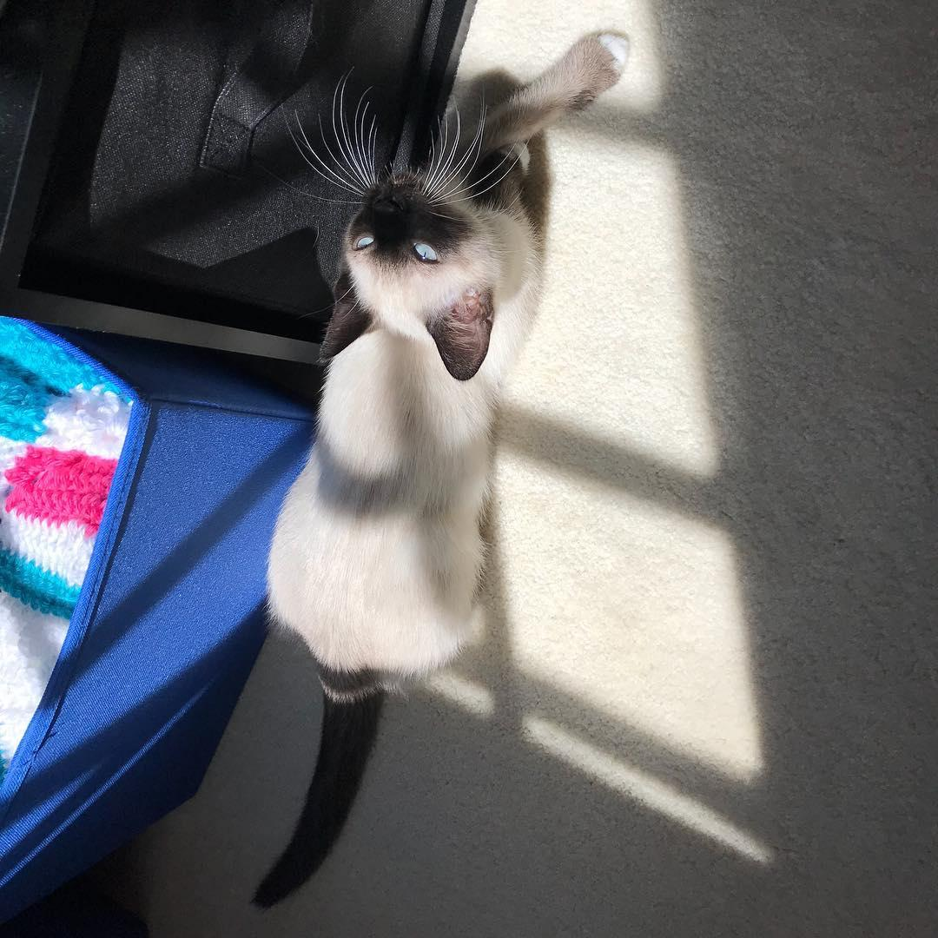
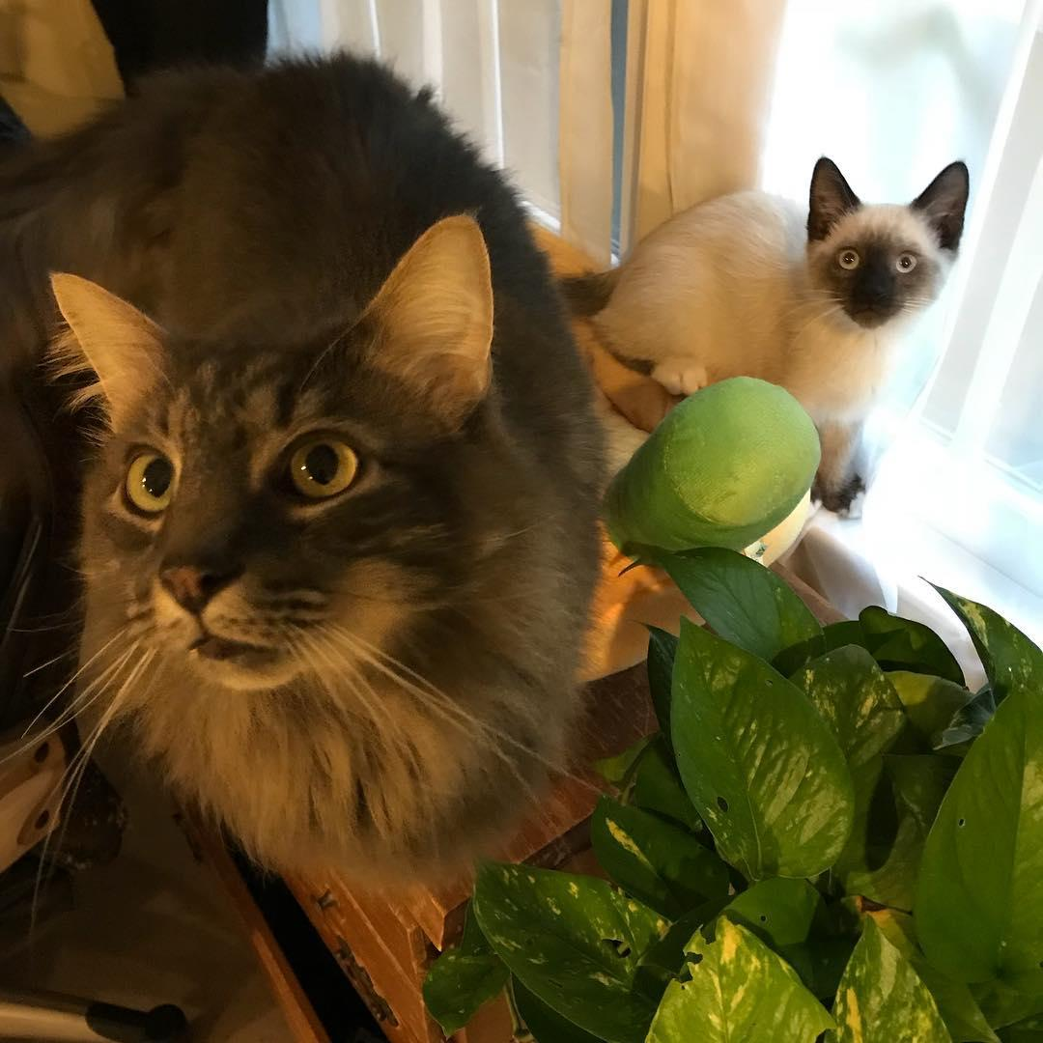
@jennydoesthings

Slide 62
@jennydoesthings

Slide 63
@jennydoesthings

Slide 64
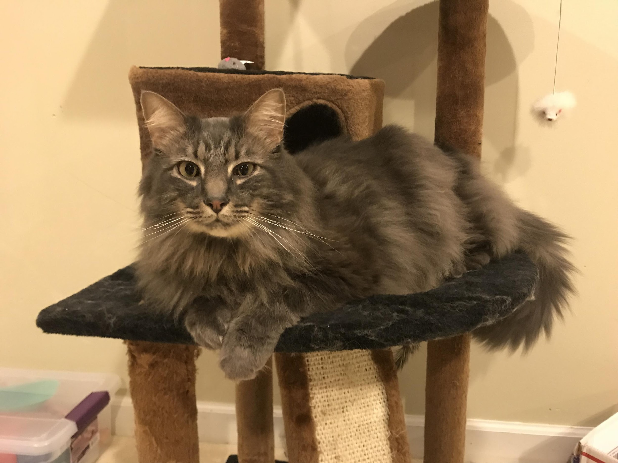
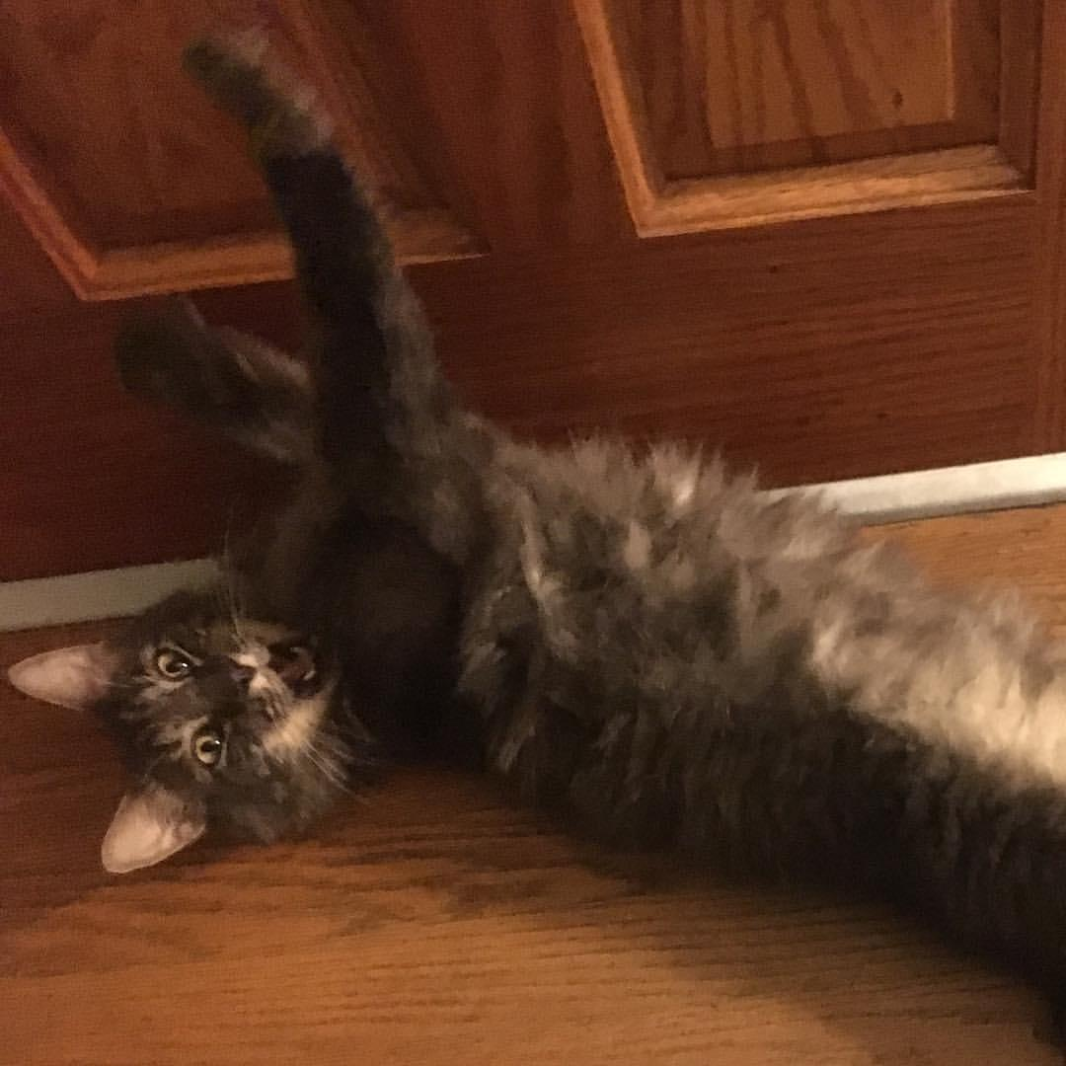
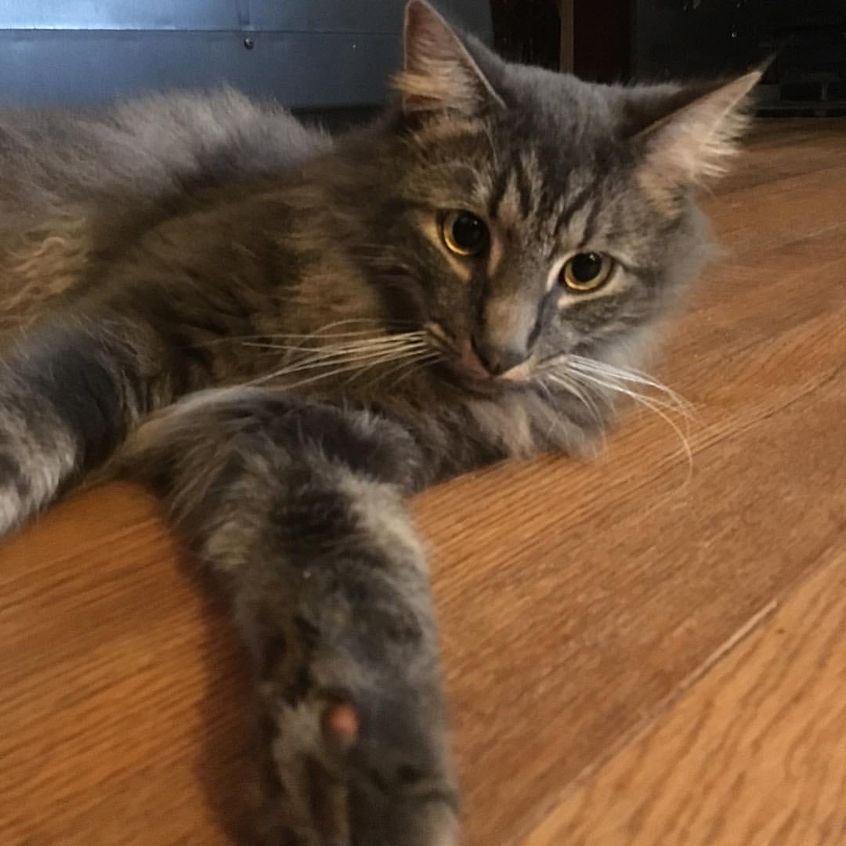
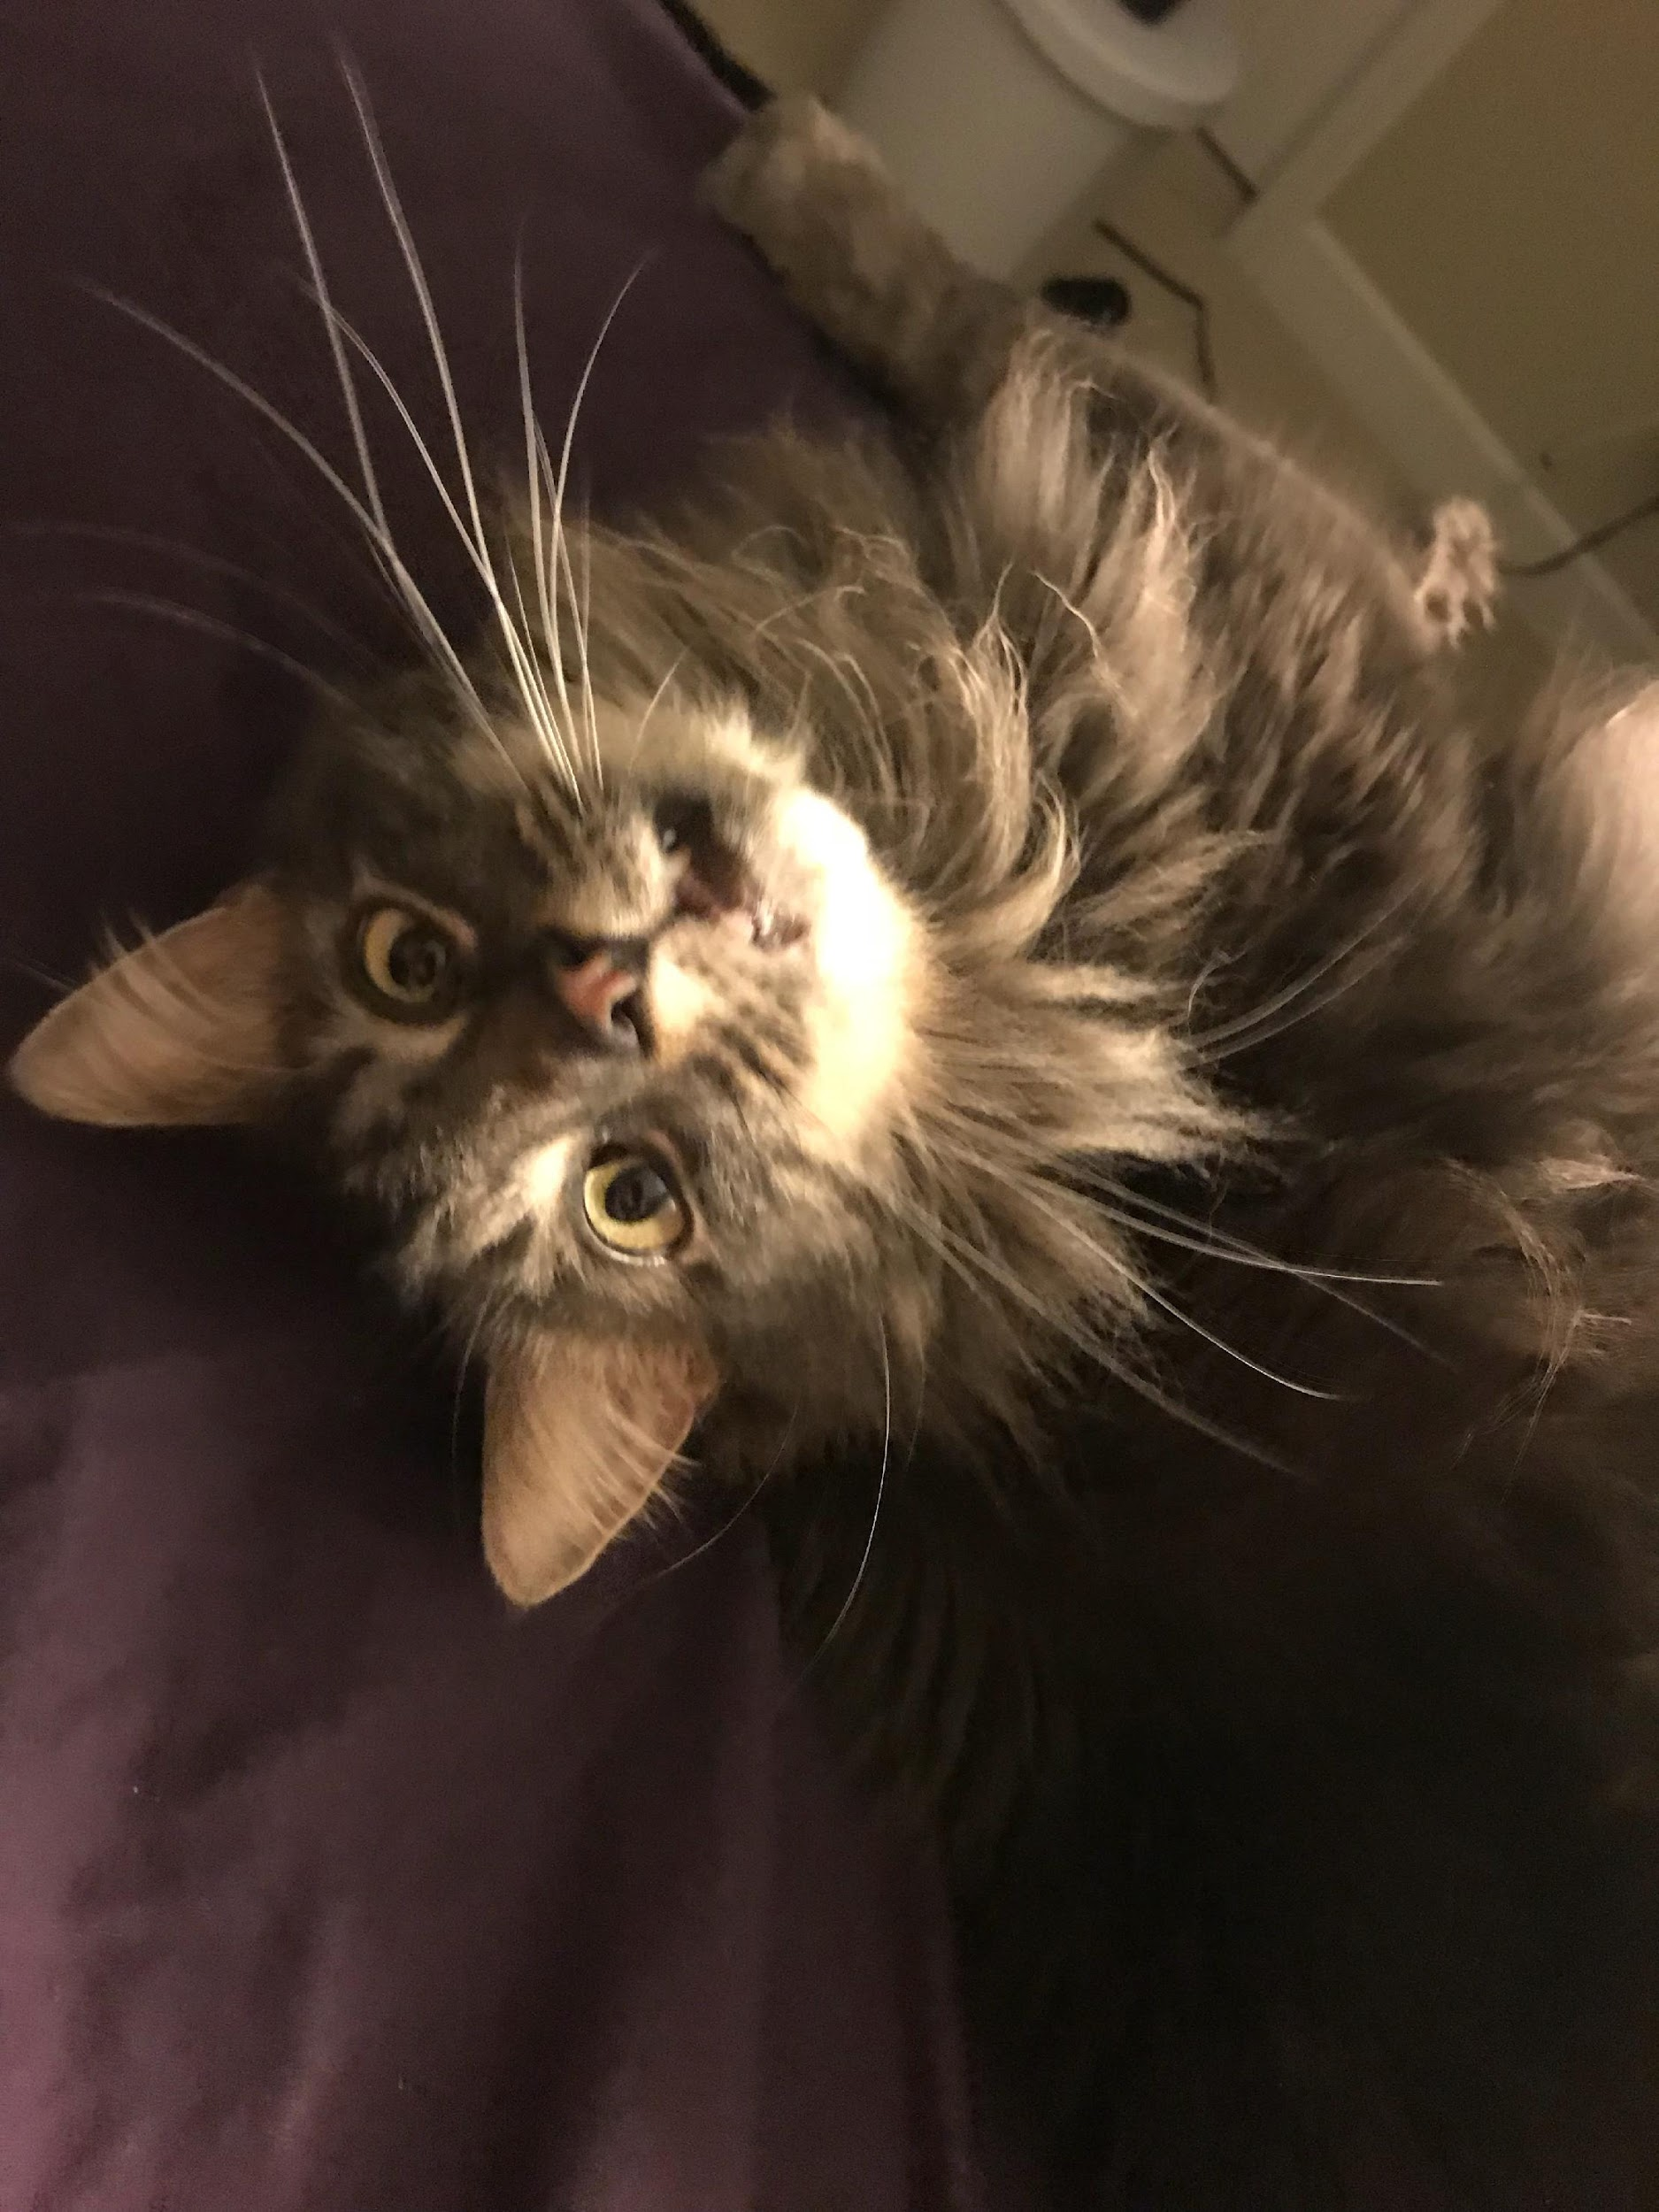
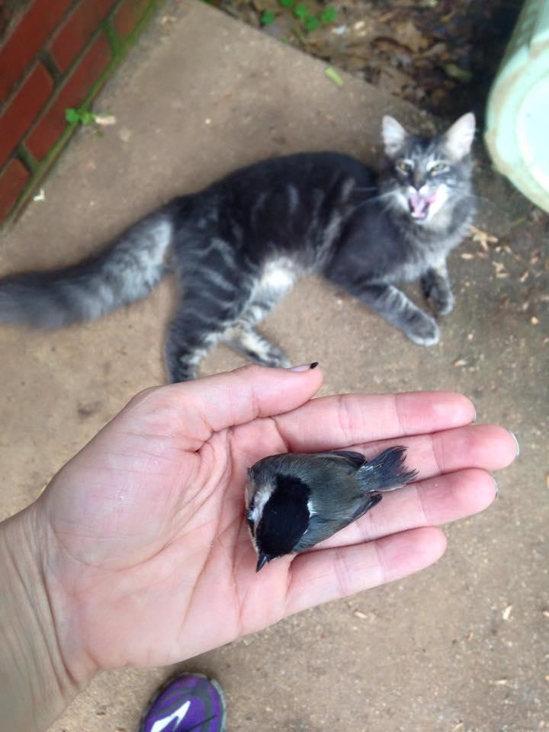
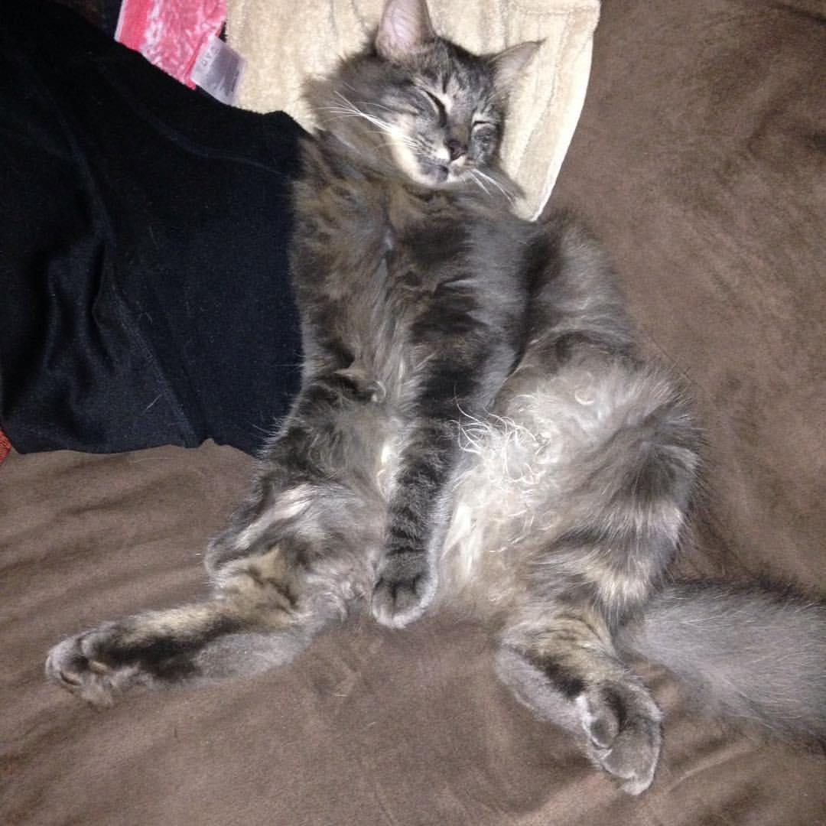
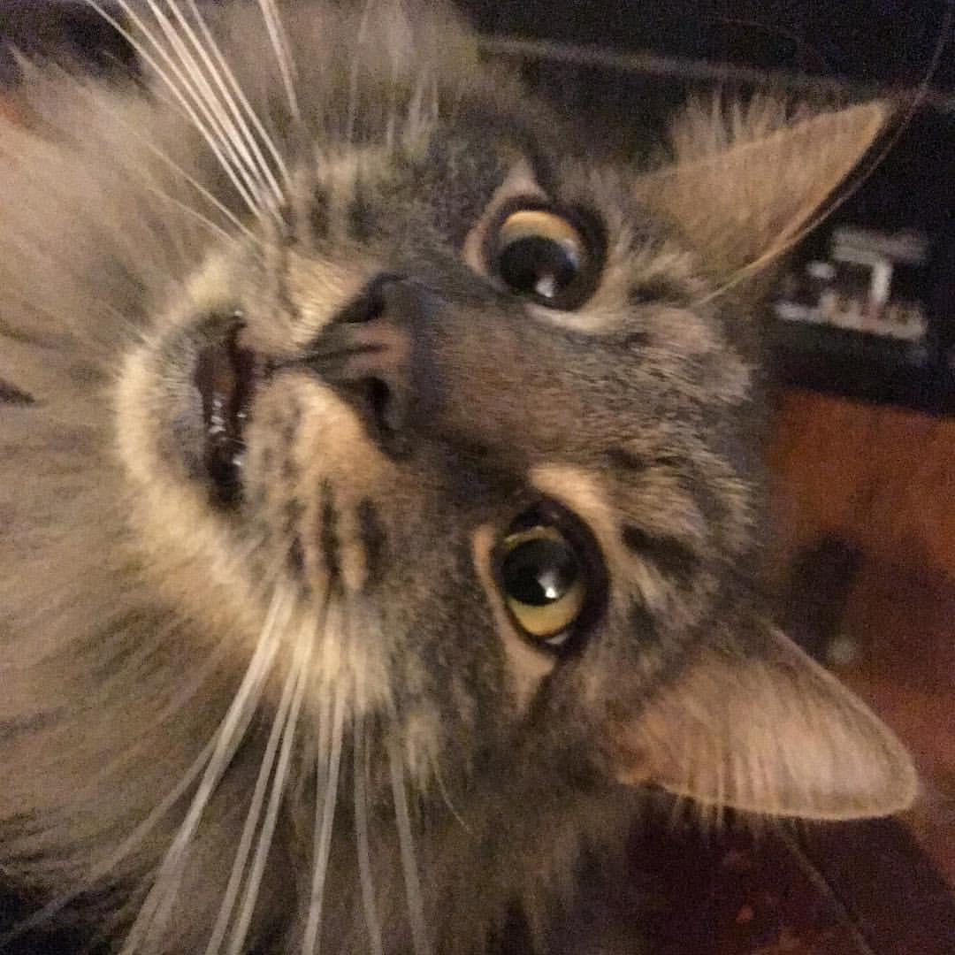
@jennydoesthings

